Slide 1
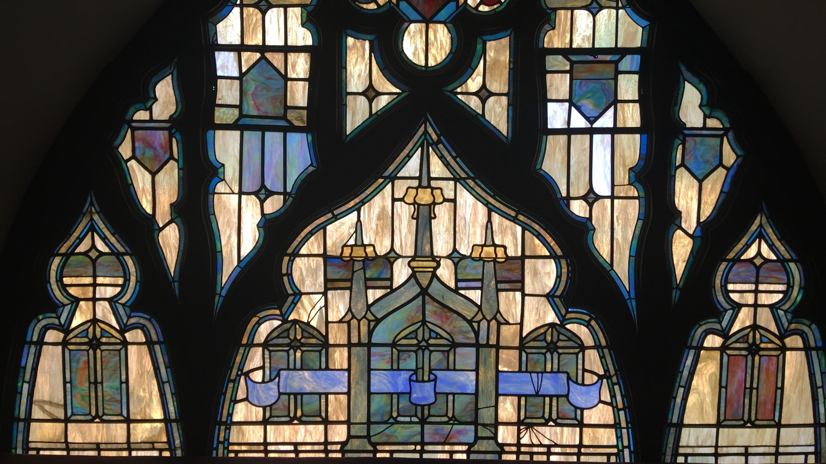


March 2026
WELCOME HOME!
Mission:
Pilgrim Congregational Church is an independent community of Christian faith which glorifies God through worship and service to others, respects individual spiritual growth, and inspires compassionate fellowship.
Vision:
Pilgrim Congregational Church is the spiritual home of our community where all people are welcomed, known, and loved.
Church Office Hours:
Monday - Friday, 9am to 4:30pm
Appointments are recommended.
Worship Service:
Sundays at 10am ~ In-person or Online
Senior Minister
Rev. Dr. Patrick Horn
Associate Minister
Rev. Heather Miner
Consulting Minister
Dr. Lowell Linden
Licensed Minister
Mr. Jon Olson
Ministers Emeriti
Rev. Dr. Elizabeth Bingham
Rev. Dr. Douglas Lobb
Music Dept.
Ms. Susan Winckler - Director
Mr. Bruce Jones - Organist
Ms. Nancy Rodewald - Children’s Music
Office Staff
Mrs. Leila Alcala - Bookkeeper
Ms. Natalie Brown - Office Manager
Mrs. Megan Parnell - Librarian
Custodial Staff
Mr. James Stevenson
Mr. Laurence Holmes
Mr. Christian Campbell
Table of Contents
2 Sr. Minister’s Message 3 Associate Minister’s Message Moderator’s Message 5 Trustees Message 6-8 Pilgrim Auxiliary 9 Library News 10-18 Christian Education | 19 Membership 20-23 Our Community Outreach 24-26 Pilgrims Information 27 Pilgrim Ministries 28 Service Notes 29/30 Church Calendar/Notes
Isaiah 60:1 “Rise Up
Pilgrim Congregational Church
600 N. Garey Avenue, Pomona, CA. 91767
Phone: (909) 622-1373 Fax: (909) 629-2554
Email: PilgrimOffice@pilgrimchurchpomona.com
Website: www.pilgrimchurchpomona.com
Facebook & YouTube: Pilgrim Congregational Church Pomona
Instagram: www.Instagram.com/pilgrimoffice
September 2025
1
Isaiah 60:1 “Rise Up
March 2026
1

Slide 2
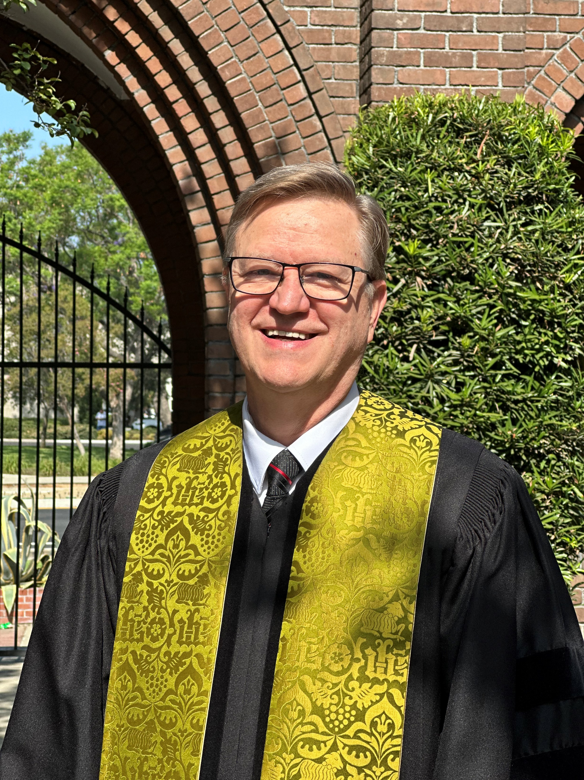
Senior Minister’s Message
God Has a Question for Us
“Mortal, can these bones live?”
Ezekiel 37:3
By: Rev. Dr. Patrick Horn
One of the most striking images in all of the Old Testament comes from the account given of Ezekiel’s spiritual trance in which he is transported to a valley full of bones. There in this valley, the Lord asks Ezekiel: “Son of Man (which the NRSV translates as ‘mortal’), can these bones live?”
While the question is directly addressed to Ezekiel, the title, “Mortal,” used here implies that it is a question for all human beings. In fact, this account served the purpose of allowing Ezekiel’s fellow exiles in Babylon to see the vision through his eyes. The passage is not chiefly about a vision of God that Ezekiel had but rather about the question of what it means to see ourselves through the eyes of God.
Thus, the question is addressed to us: Given all these bones lying around in this valley, do you believe that they can be raised up to live, again? In other words, do you believe that something obviously impossible can happen. This is the question for all people; it is a question of faith in God, of perfect goodness, perfect justice, perfect love.
The question of faith is even more deeply challenging in the context of its being addressed to the Babylonian exiles. Judah had collapsed, Jerusalem was destroyed, and Ezekiel had already denounced the people for their rebellion and sin. There was no reason to hope; they might as well be dead.
And yet, this is the question that we all must address: “Can these bones live?” Can you live in the hope of the seemingly impossible when there is no reason to hope? Can you live in the hope that all people will one day live in peace and harmony? Can you live in the hope that there will be no more tears, no more crying, because death and suffering are no more?
The question of faith comes to all of us, we no less than ancient Jewish exiles: “Mortal, can these bones live?” How will you respond?
Isaiah 60:1 “Rise Up
2

Slide 3
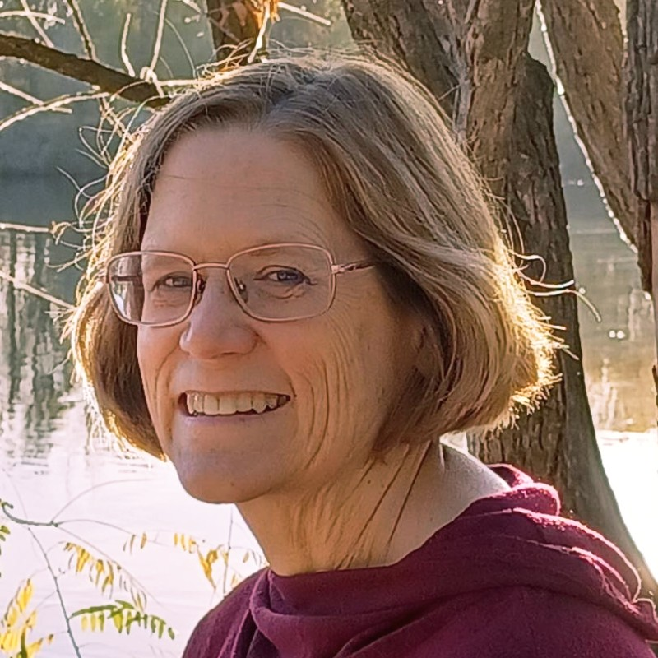

Associate Minister’s Message
Scrolling through my FB feed, I came across one of my favorite communicators named Jefferson. Jefferson sat across from another man and asked him to hold one end of a string and he held to other. He asked the other man “what is challenging about your work today?” And, as the man began to answer, Jefferson took out his phone and started to reply to a text. Of course, the string went slack.
Lent is a time to hold tight the string we have to God, our prayers, our seeking God’s word, our sitting in the Eternal One’s love.
When I pray and thoughts about my day or my yesterday intrude, I’m learning to note them as I journal, but not to follow them out. I don’t have to solve that issue or write an email because a new thought came to mind. For to follow them is like picking up the phone during a conversation. It interrupts the connection. We need time to connect with a higher love and a greater purpose…time to sit with God.
The first challenge is to find some prayer time with God where you stay with God. I journal, others talk, and still others sit in silence. Choose one to do each week, maybe each day.
The second challenge.
On Sundays, we have a time for us to collectively enter into the sanctuary to strengthen our community’s connection to God. There are Sundays when you have been asked to work—to provide the fellowship or teach. You all step into those roles beautifully.
The challenge is this…to not work once a month and instead choose to be with the church in worship. I know there are many reasons we want to keep doing what we do. You may even have a whole litany of why you don’t want to be in the sanctuary. And, yet, the intentional choice to put away the work (put away the phone) and put aside your litany to, instead, enter into worship strengthens our collective line to God. The difference will be felt both in our church and in your journey of faith.
And, an added bonus is this: Guests will get to see that we hold tight the connection to the One who gives life.
In God’s Love, Reverend Heather
Challenges
Isaiah 60:1 “Rise Up
3

Slide 4
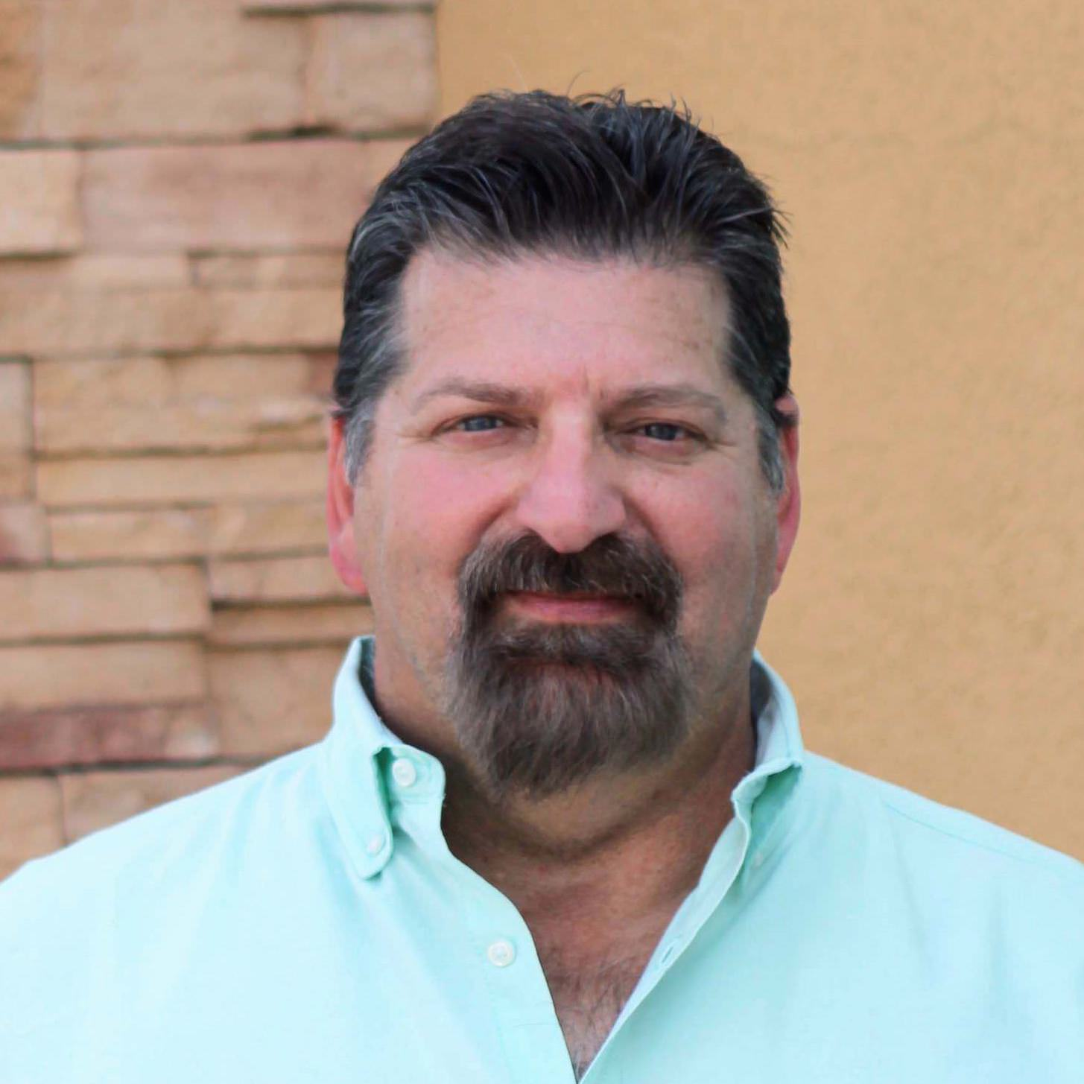
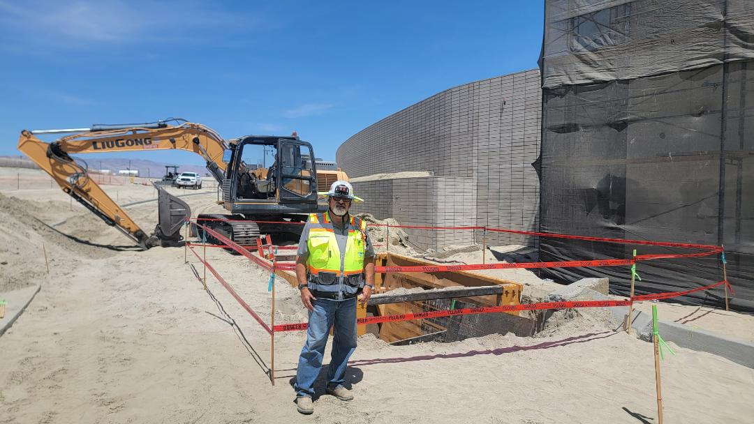
Moderator’s Message
RISE UP and BE LUCKY
Welcome to March Pilgrims – a Month where we observe Lent, change daylight saving, begin Spring and celebrate St. Patrick’s Day. A lot going on and a lot to be thankful for. So, I started thinking about St. Patrick’s Day and the “luck of the Irish.” I was wondering why the Irish were considered to have special luck and why others don’t. Then I started thinking about what luck is, really.
It’s easy to look at someone else’s life and say they’re just lucky. We notice someone who lands that awesome job, the family that scores their dream home, or the friend who always wins the raffle. Sometimes, it feels like luck is some invisible force picking favorites. But if I stop for a second, maybe luck isn’t as random as it seems.
Maybe luck is just those moments when things go my way and I didn’t expect it. But the more I pay attention, the more I realize luck pops up when I’m open, paying attention, and willing to take a shot. Think about that time you had a great conversation just because you said hi, or when an opportunity came your way because you were brave enough to try. Luck tends to hang out with people who show up, get involved, and look for good stuff in everyday life.
When it comes to faith, it’s tempting to think luck is totally separate from God’s plan. But what if luck is one of the ways God surprises us? Maybe it’s a little encouragement, a random act of kindness, or a reminder that grace is everywhere. If we start seeing luck as those small moments of divine favor—tiny blessings woven into our daily routine—it can change how we look at things.
So, I was wondering how to bring more luck into my life. I’ll be more grateful and notice little things. I’ll keep an eye out for “lucky” moments—a parking spot right when I need it, a call from a friend that made my day, or a spark of inspiration at just the right time. Luck isn’t something to chase, but something to notice and celebrate when it shows up.
My prayer for March: God, thanks for those surprise blessings that come my way. Help us to see luck as a sign you’re with us, and remind us to be grateful for all the moments, big and small. Make us people who notice and appreciate the ways you surprise us every day. Amen.
Ron Vanyo, Moderator
Isaiah 60:1 “Rise Up March 2026 4

Slide 5
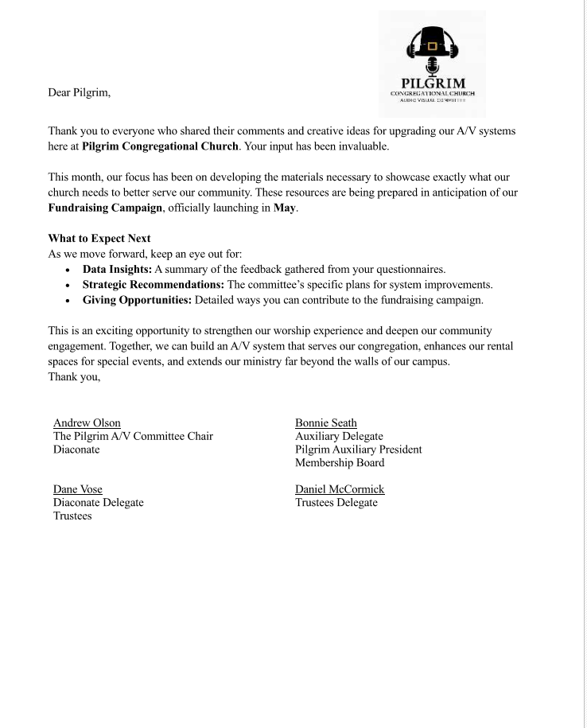
Audio Visual Message

Slide 6

Auxiliary

Slide 7

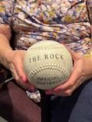
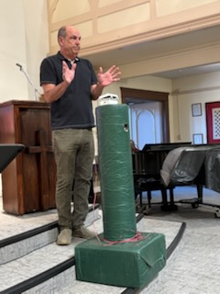
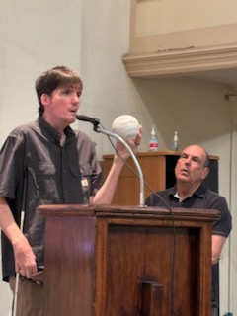
Auxiliary
Thank you, Darren and Darrell Keepers who delivered a great program, describing how Beep Baseball is played , along with a fun and informative video. How Darren formed his non-profit, So Cal Beep Baseball and his team, The Panthers. They brought equipment along for people to get a hands-on idea of the sound that the ball makes and the base makes for the players to locate them. There were a lot of great questions asked, by many that attended. It was a great program. Thank you so much for supporting So Cal Beep Baseball. It was a pleasure to share with you all.
We hope you can make it out to the field soon, to experience the game yourself!
Darren and Darrell

Slide 8
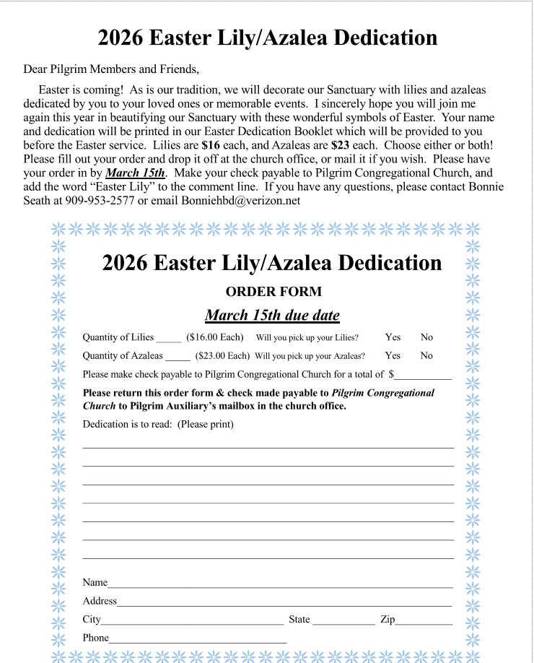
Auxiliary

Slide 9

From the Librarian
MARCH 2026 LIBRARY NEWS
Thank you to all who came to the Library Coffee on February 1st to hear Joe Blackstock talk about his book From Haven to Hell. We had a good turnout, over 70 people, including many from the community at large. Joe sold all the copies he brought with him, but don’t worry if you missed your chance to purchase, more are on the way. Our own Guadalupe Oceguera won the raffle which was a copy of Joe’s book. The reader who read the most books in 2025 was Cynthia Shoultz who passed away just before Christmas. The library committee honored her memory by dedicating the altar flowers and the Library Coffee to her. Due to requests we had planned to record and post the talk but despite the best efforts of the video crew (Andrew, Bill and Dane) they were unable to resolve the technical issues.
New books:
Fiction
The Case of the Unsuitable Suitor by Cathy Ace
The King’s Ransom by Janet Evanovich
Theo of Golden by Allen Levi
Murder on the Books by Toni LoTempio
A Matter of Pedigree by Lesle Meier
The Time Hop Coffee Shop by Phaedra Patrick
Return of the Spider by James Patterson
Murder in Tuscany by T.A. Williams
Non-Fiction
Humor Me by Chris Duffy
Eat Your Ice Cream by Ezekiel Emanuel
100 Rules for Living to 100 by Dick Van Dyke
Isaiah 60:1 “Rise Up
9

Slide 10

Christian Education
Isaiah 60:1 “Rise Up
10

Slide 11




Christian Education

Slide 12

Christian Education

Slide 13
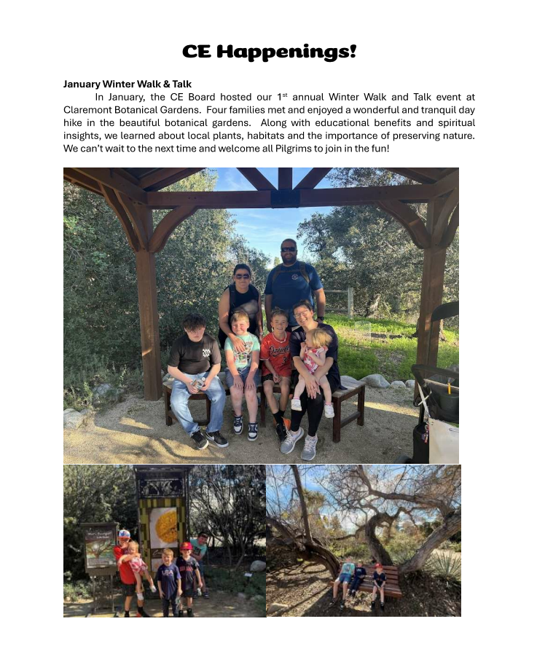
Christian Education
Isaiah 60:1 “Rise Up March 2026 13

Slide 14
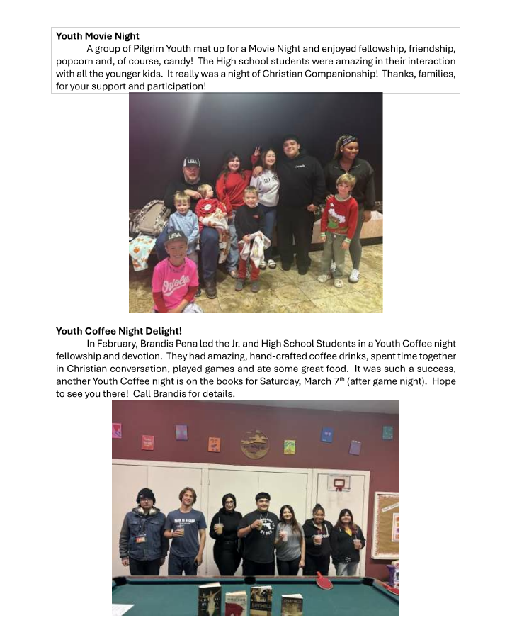
Christian Education

Slide 15
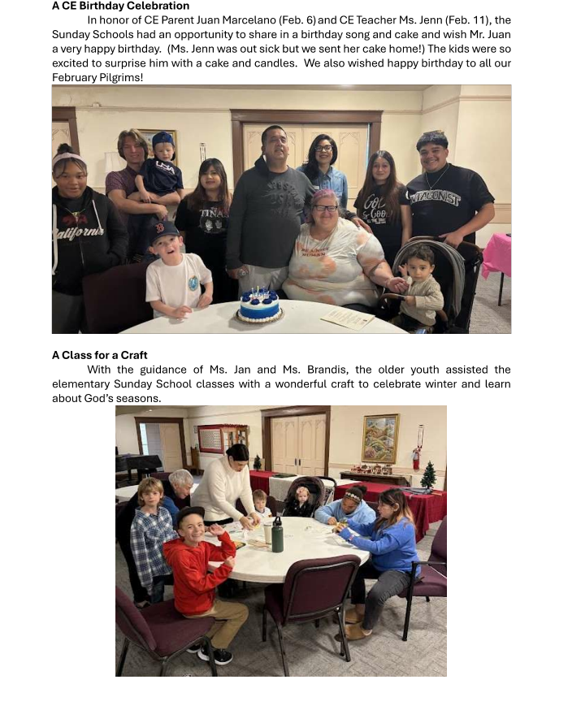
Christian Education

Slide 16
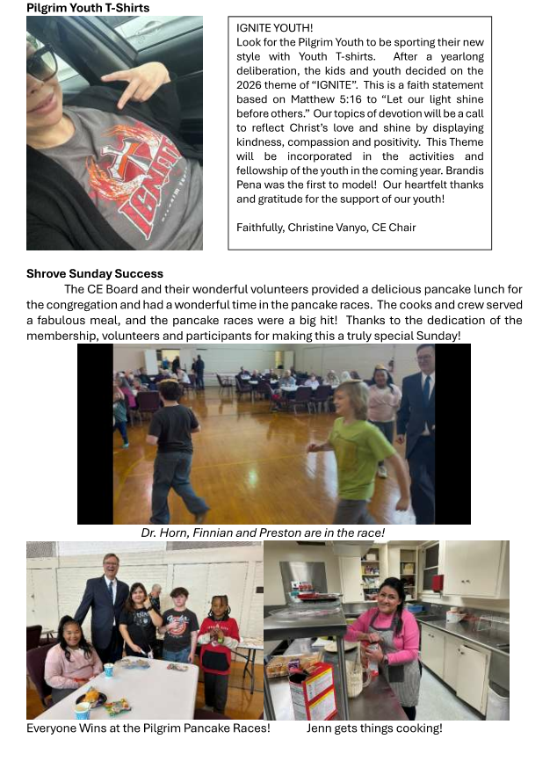
Christian Education

Slide 17
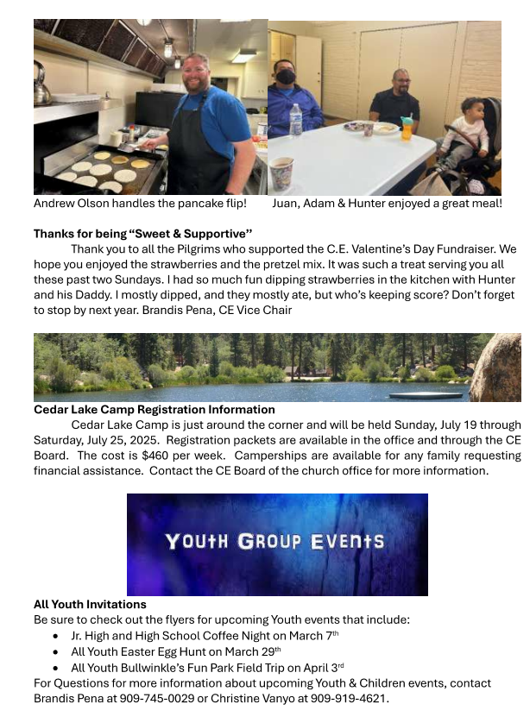
Christian Education

Slide 18
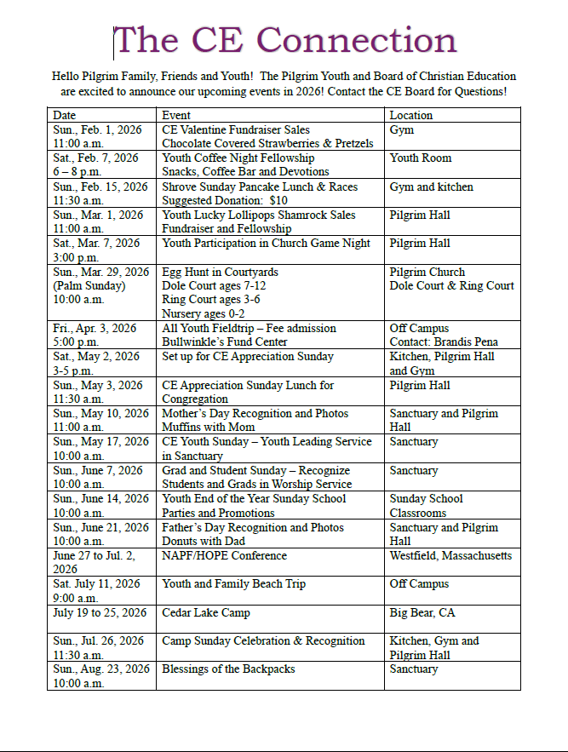
Christian Education
Isaiah 60:1 “Rise Up
18

Slide 19


Membership
Don’t forget to save the date for Bingo Night!
May 9th, at 5:00 pm. Join the fun!
Isaiah 60:1 “Rise Up
19

Slide 20

Community

Slide 21
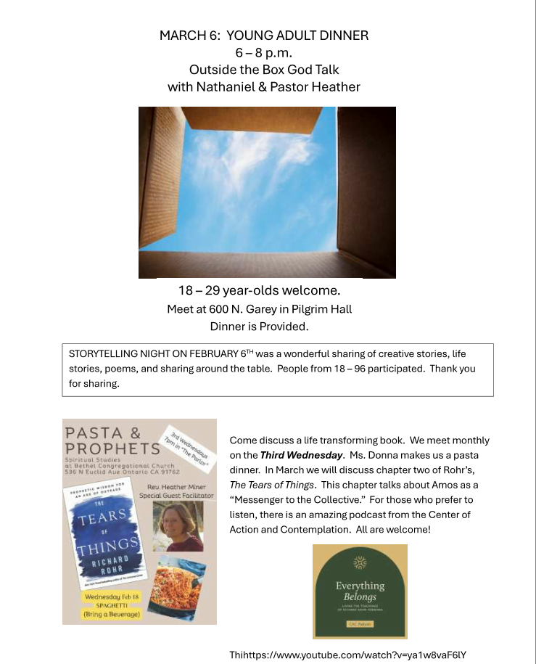
Our Community Outreach
Isaiah 60:1 “Rise Up
March 2026 21

Slide 22

Community

Slide 23

Community

Slide 24
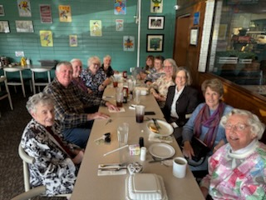
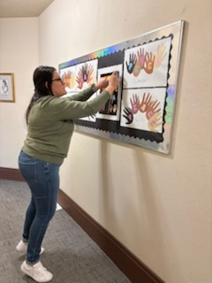
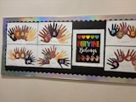
Pilgrim’s Information
Lunch Bunch had a nice lunch at The Iron Skillet in January.
Thank you to Jenn Bartnett for putting up this great PEACE bulletin board the kids made for Martin Luther King Day.
Lost and Found
Hello Pilgrims, last month the following items were found in different areas in the church. If you, or anyone you know, has lost any of these items listed or not listed and you’ve lost something in the past, please call or come to the church office. Also, any found items, please turn them into the office.
Prescription Eye Glasses
Several Water Bottles
Purple silk pant suit
Blue waterproof jacket
A Pods Key
Costco Optical Eye Glass Case
Pink Charger Pack
Please note if items are not picked by the following month, we will send to rummage.
Isaiah 60:1 “Rise Up
24
March 2026

Slide 25
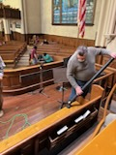
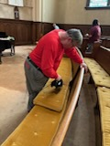
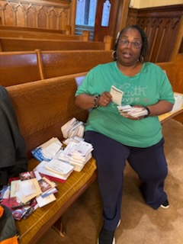
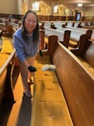
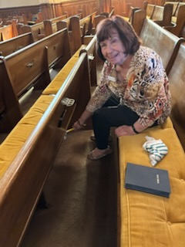
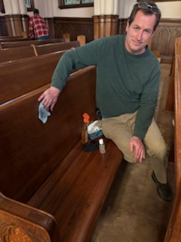
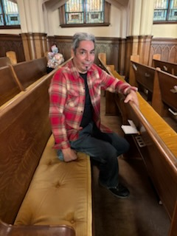
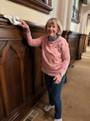
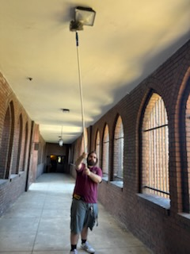
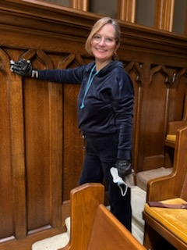
Pilgrim’s Information
In the Month of January, we had an all church clean up day and here are some of the wonderful volunteers that came out to help and beautify our church. Pilgrims were all over the facility, some in the kitchen, Pilgrim’s Hall, Nursery and some class rooms. A Big Thank you to all of you!
From top left to right:
Ron, Keith, Natalie, Karen,
Second row:
Sylvia, Jason, Angelo, Susan S.,
Third Row:
Christian and Dulce
Others not shown:
Patty, Judy, Jan, Dane, Bonnie, Linda, Sue S., Karen L, Bill, Cynthia

Slide 26
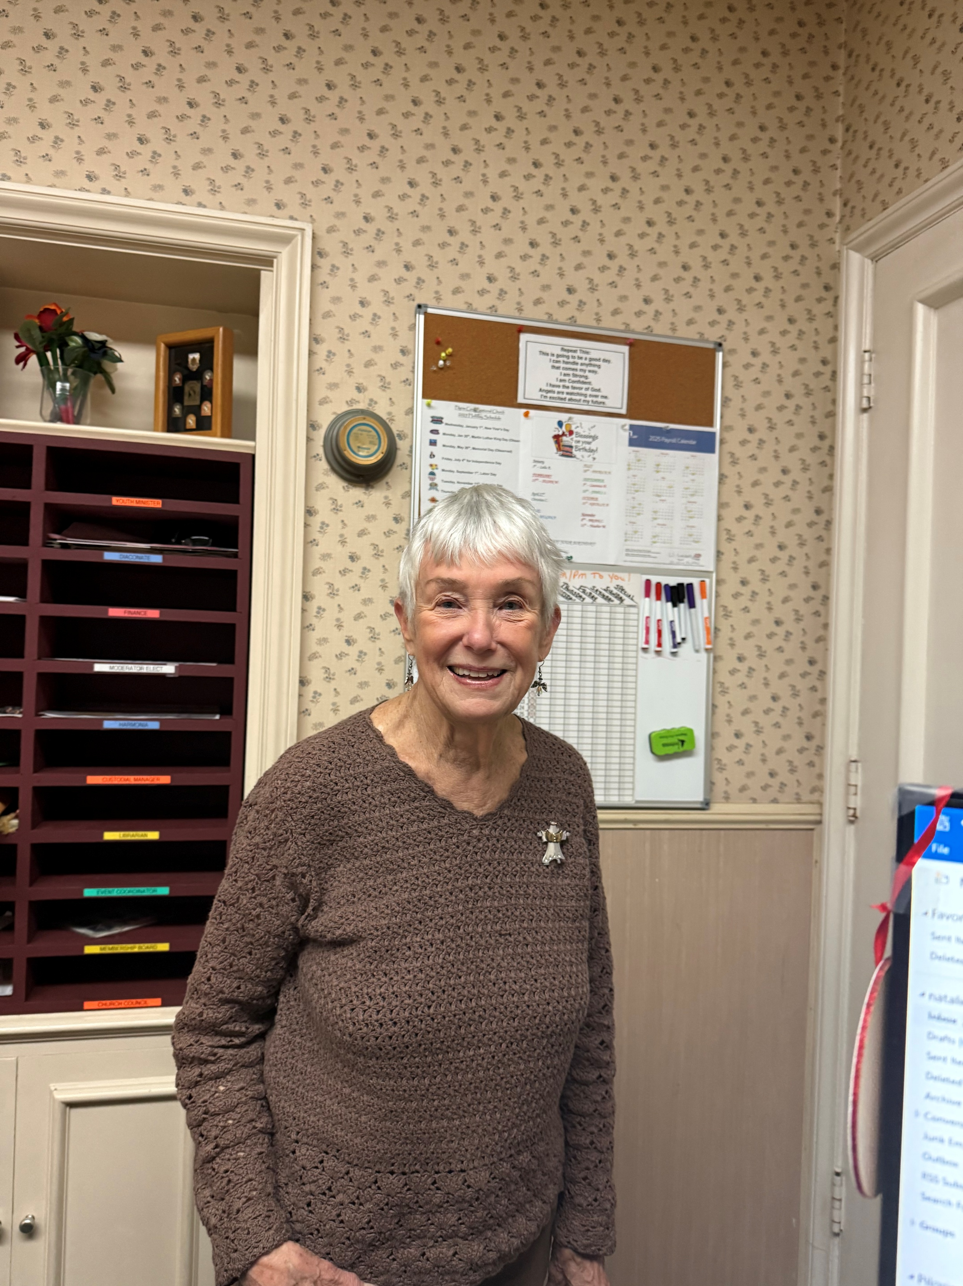


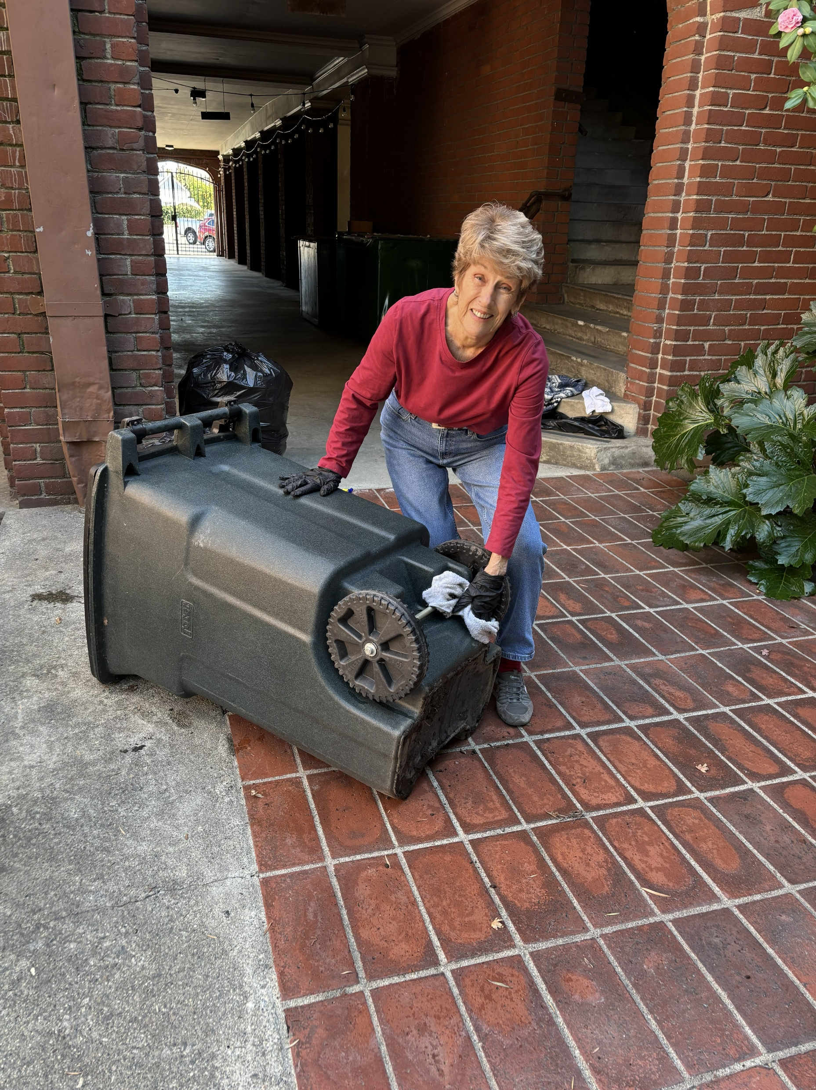
Pilgrim’s Information (Clean up day Con’t)
A Big Thank you to Ms. Jan Manildi for taking all the pictures on clean up day.
Thanks to Patty Schelling our Recycle Bin for the Rop Mercy Foundation Project is sparkling clean! Your recyclable contributions will help to support High School students in Kenya with school fees and supplies.
Please donate your clean plastic bottles, aluminum cans and items with CRV codes to this ongoing very worthwhile project. Thank you.

Slide 27


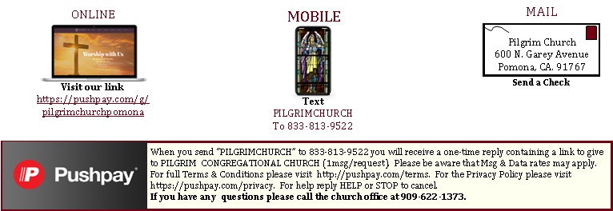
Church Ministries
Band of Prayer
If you or someone you know is in need of prayers, please send your Band of Prayer requests to Sue Shedd via email at saintshedd@roadrunner.com or leave a message at 909-622-1373.
Card Corner
Every 3rd Sunday during Fellowship Hour the Card Corner will be available with cards and addresses for Pilgrim members to share a friendly note with our families out of state, homebound or we just haven’t seen in awhile. Stop by and write a card to let our Pilgrims know we are thinking about them.
Ways To Give
When you text “PILGRIMCHURCH” to 833-813-9522 you will receive a one-time reply containing a link to give to PILGRIM CONGREGATIONAL CHURCH (1msg/request). Please be aware that MSG & Data rates may apply. For full Terms & Conditions please visit http://pushpay.com/terms. For the Privacy Policy please visit https://pushpay.com/privacy. For help reply HELP or STOP to cancel. If you have any questions, please call the church office at 909-622-1373.
Isaiah 60:1 “Rise Up March 2026 27

Slide 28


March Service Notes
March 1st ^{Second Sunday in Lent} Presiding Minister: Rev. Dr. Patrick Horn Worship Assistant: Rev. Heather Miner ^{Lesson 1: Romans 4:1-5; 13-17} ^{Lesson 2: Genesis 12:1-4a} ^{Color: Purple} Theme: God’s Plan for the Whole World Sermon: “All the Families of the Earth” Ushers: Susan Shedd, Sharon Willison, Lisa Keepers & Michael Lawing Acolytes: Isabella & Jasmine Marceleno Fellowship Host: Library Committee This morning’s flowers are lovingly and thoughtfully provided by Janet Beech: “Pilgrim is Family. We are so lucky!!” March 8th ^{Third Sunday in Lent} Presiding Minister: Rev. Dr. Patrick Horn Worship Assistant: Rev. Heather Miner & Mr. Jon Olson ^{Lesson 1: Romans 5:1-11} ^{Lesson 2: Exodus 17:1-7} ^{Color: Purple} Theme: God is the only true provider of miracles Sermon: “The One True Miracle Worker” Ushers: : Sylvia Osborn, Jenni Whyte & Steve Whyte Fellowship Host: Library Committee This morning’s flowers are thoughtfully and lovingly provided by Ron and Christine Vanyo: “Happy 8th Birthday to our Grandson, Harrison. From the moment you entered our lives, you have filled our hearts with so much love and happiness. Watching you grow, learn, and explore has been such a blessing. We are so proud of the kind, curious, and adventurous boy you are becoming. Your imagination inspires us all, and your smile brightens every room. Remember, you are loved beyond measure, and we will always be here to cheer you on, no matter where life takes you. Prayers for God’s continued grace upon your future. Love, Fafa & Gigi (Ron & Christine Vanyo) | March 15th ^{Fourth Sunday in Lent} Presiding Minister: Rev. Dr. Patrick Horn Worship Assistant: Rev. Heather Miner ^{Lesson 1: Ephesians 5:8-14} ^{Lesson 2: 1 Samuel 16:1-13} ^{Color: Purple} Theme: Grace comes in the most unexpected ways ^{Sermon: “What is Possible”} Ushers: Ben Selters, Sue Selters & Janet McBride ^{Acolytes: Kodie Gray} Fellowship Host: Friendship Guild This morning’s flowers are thoughtfully and lovingly provided by Bonnie Seath: “Happiest of Birthday Wishes to grandma Vicki, brother-in-law Jim, and “Princess” Eva! Warm hugs and another huge bushel of Love to each of You on your Special Day!” March 22th ^{Fifth Sunday in Lent} Presiding Minister: Rev. Dr. Patrick Horn Worship Assistant: Rev. Heather Miner & Rev. Keith Eades ^{Lesson 1: Romans 8:6-11} ^{Lesson 2: Ezekiel 37:1-14} ^{Color: Purple} Theme: Life is a question of faith Sermon: “God Has a Question for Us” Ushers: Ron Vanyo, Dulce Ruiz, Bob Wheeler and Guadalupe Oceguera Acolytes: Preston Dague & Charlie McCormick ^{Fellowship Host: Diaconate} Our flowers this morning are thoughtfully provided with many thanks to Susan Winckler, Bruce Jones, and our extraordinary Choir for their beautiful music every Sunday.” March 29th ^{Palm Sunday} Presiding Minister: Rev. Heather Miner Worship Assistant: Rev. Dr. Patrick Horn ^{Lesson 1: Matthew 21:1-11} Lesson 2: Psalm 118: 1-2, 19-29 ^{Color: Purple} Theme: God’s steadfast love calls for celebration even amidst the confusion ^{Sermon: “A Song of Victory”} Ushers: Susan Shedd, Sharon Willison, Lisa Keepers & Michael Lawing Acolytes: Isabella & Jasmine Marceleno Fellowship Host: Palm Sunday Music Board PALM SUNDAY- This morning’s flowers are lovingly and thoughtfully provided: “To the Glory of God for His Gift of Eternal Life.” Boutonnieres for March are provided: “In appreciation to ALL Who so generously dedicate their time, talents, and treasures to Pilgrim Congregational Church.”
Green symbolizes growth and life, hope and anticipation. Green is used in Ordinary time, the period of the Church calendar which gives attention to the Lord’s life and ministry; it reminds us that the mission of the Church is to love the world and share the hope of Christ.
Purple was originally associated with royalty because it was a more expensive color to dye, and it was used to welcome the coming of a king. It also evokes pain and suffering. Purple symbolizes fasting, faith, patience, and trust. It is the liturgical color used during the seasons of penance, Advent, and Lent. For Advent, purple symbolizes the impending birth of Jesus while foreshadowing his death.
Liturgical Notes by Rev. Dr. Patrick Horn
White symbolizes purity, innocence and birth. It is associated with the brightness of the heavens during daytime and was used to symbolize the purity of heaven and the angels. It also came to be associated with joy, celebration, and peace. White is the Liturgical color of Christmas, Epiphany, and Easter.
To Listen to the Sunday Service on your Phone: Dial +1-669-900-9128. Then when prompted, enter the Meeting ID: 330 195 900, followed by the pound (#) sign. Then enter Passcode 1887, followed #. To View Sunday Service Online: Visit Facebook Page or YouTube Channel at: Pilgrim Congregational Church Pomona.
Isaiah 60:1 “Rise Up March 2026 28

Slide 29
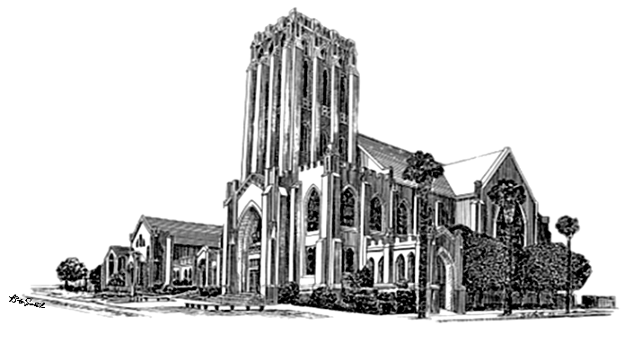

Calendar Notes: March 2026
Weekly / monthly Every Morning, Mon. - FRI. Daily Devotional 9am via Facebook Live and Zoom Every Sunday 9am – Gather & Greet 9:30 to 9:45 am, Bible Study with Rev. Miner 10am – Worship Service (In-person & Online) Sunday School for 1st – 12th grade (following the Lord’s Prayer) 11am - Fellowship Hour Every Monday 11:30 am, Living Faith Bible Study 1:00 pm, Staff Meeting Every Tuesday Twilight Bible Study 5:45pm via Facebook Live & YouTube Every 1st Tuesday (October - June) Pilgrim Auxiliary Meeting, Program & Luncheon Every Wednesday 9am to 10:30am ~ Rummage Sorting Every 1st Wednesday 7pm ~ Church Council Meeting Every Thursday 10am ~ Joyful Endeavors Every Friday 8am ~ Men’s Breakfast at Roberta’s Inn, La Verne EVERY 3rd SUNDAY 11:30am ~ Meeting Sunday EVERY 4th SUNDAY 11:30am ~ Trustees Board Meetings EVERY 5th SUNDAY Sunday Funday (Sunday School) | UPCOMING EVENTS March 1st 11:30 am, Choir Rehearsal March 3rd 10:00 am, Pilgrim Auxiliary Meeting, Program and Lunch March 4th 7:00 pm, Church Council Meeting March 6th 6:00 pm, Young Adult Dinner & God Talk March 7th 3:00 pm, All Church Game Day 5:00 pm, Youth Coffee Night March 8th Daylight-Saving Time Begins March 9th 6:00 pm, CE Zoom Meeting March 15th 11:30 am, Choir Rehearsal 11:30 am, Diaconate Board Meeting 11:30 am, Meeting Sunday March 22nd 11:30 am, Board of Trustees Meeting 11:30 am, Choir Rehearsal March 25th 9:30 am, Library Committee Meeting March 29th 11:00 am, Palm Sunday Brunch Fellowship 11:00 am, Easter Egg Hunt March 7th
Isaiah 60:1 “Rise Up March 2026 29

Slide 30









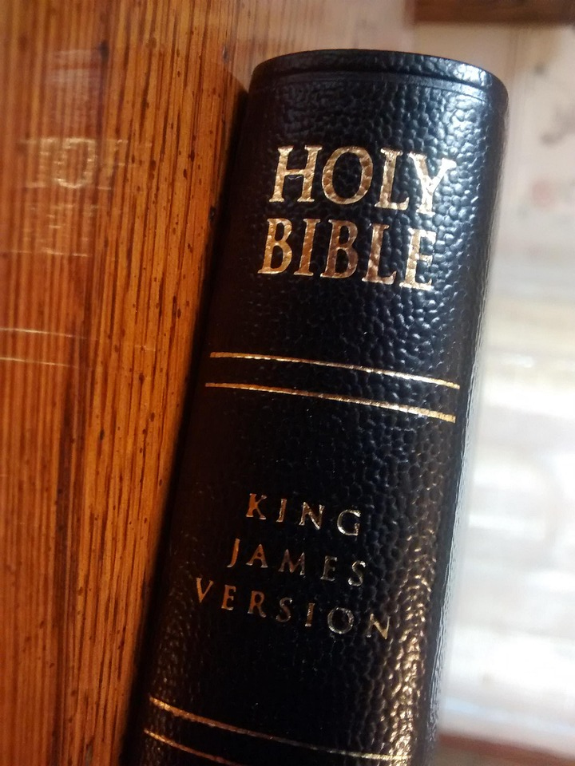












Sunday | Monday | Tuesday | Wednesday | Thursday | Friday | Saturday
1 9:00am Bible Study 9:00am Gather & Greet 9:45am Worship Service 11:00am Fellowship Hour 11:30am Choir Rehearsal 1:00pm Pentecost Temple Ministries | 2 9:00am Morning Devotional 10:00am Alanon "Serenity" 11:30am Living Faith Bible Study 7:30pm Mountainside Rehearsal | 3 9:00am Morning Devotional 9:00am Pilgrim Auxiliary set up 9:30am CEA/HOW 10:00am Pilgrim Auxiliary Meeting 3:30pm Pomona Moose 5:15pm Young Champions Cheerleaders 5:45pm Twilight Bible Study | 4 9:00am Morning Devotional 9:00am Rummage Sorting 6:00pm Basketball 7:00pm Church Council Meeting 7:30pm NA Support | 5 9:00am Morning Devotional 10:00am Joyful Endeavors 7:30pm AA Mother Group | 6 9:00am Morning Devotional 8:00am Men's Breakfast 6:00pm Young Adult Dinner & God Talk | 7 12:00pm NA Group Meeting 3:00pm All Church Game Day 5:00pm Youth Coffee Night
8 Daylight-Saving Time Begins 9:00am Bible Study 9:00am Gather & Greet 9:45am Worship Service 11:00am Fellowship Hour 1:00pm Pentecost Temple Ministries | 9 9:00am Morning Devotional 9:00am Sigma Chi Meeting 10:00am Alanon "Serenity" 11:30am Living Faith Bible Study 6:00pm Zoom CE Meeting 6:30pm Mountainside Board Meeting 7:30pm Mountainside Rehearsal | 10 9:00am Morning Devotional 9:00am Sigma Chi Meeting 9:30am CEA/HOW 5:15pm Young Champions Cheerleaders 5:45pm Twilight Bible Study | 11 9:00am Morning Devotional 9:00am Rummage Sorting 9:00am Sigma Chi Meeting 6:00pm Basketball 7:30pm NA Support | 12 9:00am Morning Devotional 9:00am Sigma Chi Meeting 10:00am Joyful Endeavors 7:30pm AA Mother Group | 13 9:00am Morning Devotional 8:00am Men's Breakfast 9:00am Sigma Chi Meeting 7:00pm Mountainside Dress Rehearsal | 14 9:00am Sigma Chi Meeting 9:45am TBI Survivors 12:00pm NA Group Meeting 1:00pm
15 9:00am Bible Study 9:00am Gather & Greet 9:45am Worship Service 11:00am Fellowship Hour 11:30am Choir Rehearsal 11:30am Diaconate Board 11:30am Meeting Sunday 1:00pm Pentecost Temple Ministries 2:00pm Mountainside Concert | 16 9:00am Morning Devotional 10:00am Alanon "Serenity" 11:30am Living Faith Bible Study 7:30pm Mountainside Rehearsal | 17 9:00am Morning Devotional 9:30am CEA/HOW 3:30pm Pomona Moose 5:15pm Young Champions s 5:45pm Twilight Bible Study | 18 9:00am Morning Devotional 9:00am Rummage Sorting 6:00pm Basketball 7:30pm NA Support | 19 9:00am Morning Devotional 10:00am Joyful Endeavors 12:00pm Lions Club Lunch 7:30pm AA Mother Group | 20 9:00am Morning Devotional First Day of Spring 8:00am Men's Breakfast | 21 12:00pm NA Group Meeting
22 9:00am Bible Study 9:00am Gather & Greet 9:45am Worship Service 11:00am Fellowship Hour 11:30am Board of Trustees 11:30am Choir Rehearsal 12:30pm Insan Foundation 1:00pm Pentecost Temple Ministries | 23 9:00am Morning Devotional 10:00am Alanon "Serenity" 11:30am Living Faith Bible Study 7:30pm Mountainside Rehearsal | 24 9:00am Morning Devotional 9:30am CEA/HOW 5:15pm Young Champions Cheerleaders 5:45pm Twilight Bible Study | 25 9:00am Morning Devotional 9:00am Rummage Sorting 9:30am Library Committee 6:00pm Basketball 7:30pm NA Support | 26 9:00am Morning Devotional 10:00am Joyful Endeavors 7:30pm AA Mother Group | 27 9:00am Morning Devotional 8:00am Men's Breakfast | 28 9:00am Palm Sunday Set-up 12:00pm NA Group Meeting
29 9:00am Bible Study 9:00am Gather & Greet 9:45am Worship 11:00am Easter Egg Hunt 11:00am Fellowship Hour 11:00am Palm Sunday Brunch 1:00pm Pentecost Temple | 30 9:00am Morning Devotional 10:00am Alanon "Serenity" 11:30am Living Faith Bible Study 7:30pm Mountainside Rehearsal | 31 9:00am Morning Devotional 9:30am CEA/HOW 3:30pm Pomona Moose 5:15pm Young Champions 5:45pm Twilight Bible study

