Slide 1
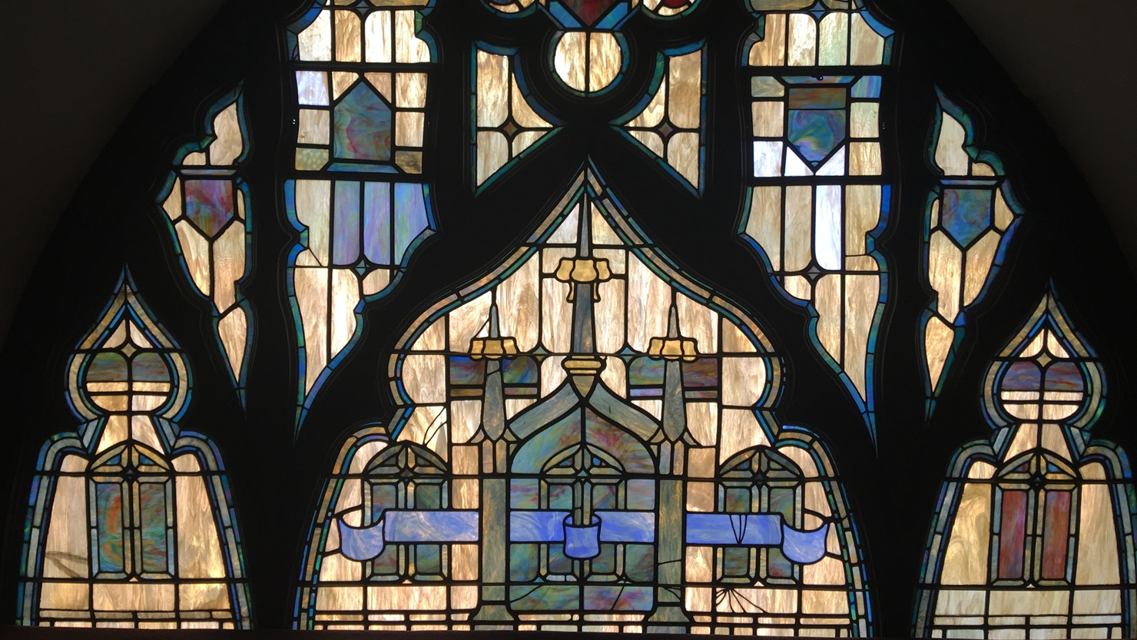


August 2025
WELCOME HOME!
Mission:
Pilgrim Congregational Church is an independent community of Christian faith which glorifies God through worship and service to others, respects individual spiritual growth, and inspires compassionate fellowship.
Vision:
Pilgrim Congregational Church is the spiritual home of our community where all people are welcomed, known, and loved.
Church Office Hours:
Monday - Friday, 9am to 4:30pm
Appointments are recommended.
Worship Service:
Sundays at 10am ~ In-person or Online
Senior Minister
Rev. Dr. Patrick Horn
Associate Minister
Rev. Heather Miner
Consulting Minister
Dr. Lowell Linden
Licensed Minister
Mr. Jon Olson
Ministers Emeriti
Rev. Dr. Elizabeth Bingham
Rev. Dr. Douglas Lobb
Music Dept.
Ms. Susan Winckler - Director
Mr. Bruce Jones - Organist
Ms. Nancy Rodewald - Children’s Music
Office Staff
Mrs. Leila Alcala - Bookkeeper
Ms. Natalie Brown - Office Manager
Mrs. Megan Parnell - Librarian
Mr. Brian Cochran - Mktg. & Media Mgr.
& Events Coordinator
Custodial Staff
Mr. James Stevenson
Mr. Laurence Holmes
Mr. Christian Campbell
Table of Contents
2 Sr. Minister’s Message 3 Associate Minister’s Message Moderator’s Message 5 Trustees Message 6 Library News 7-11 Christian Ed.’s Summer Schedule ~Summer Fun & More 12 Nursery/Rummage | 13-14 Membership 15 Harmonia Movie Night 16-18 Our Community 19 Pilgrim Ministries 20 Service Notes 21/22 Church Calendar/Notes
Pilgrim Congregational Church
600 N. Garey Avenue, Pomona, CA. 91767
Phone: (909) 622-1373 Fax: (909) 629-2554
Email: PilgrimOffice@pilgrimchurchpomona.com
Website: www.pilgrimchurchpomona.com
Facebook & YouTube: Pilgrim Congregational Church Pomona
Instagram: pilgrim_church_pomona
Isaiah 60:1 “Rise Up
August 2025
1

Slide 2
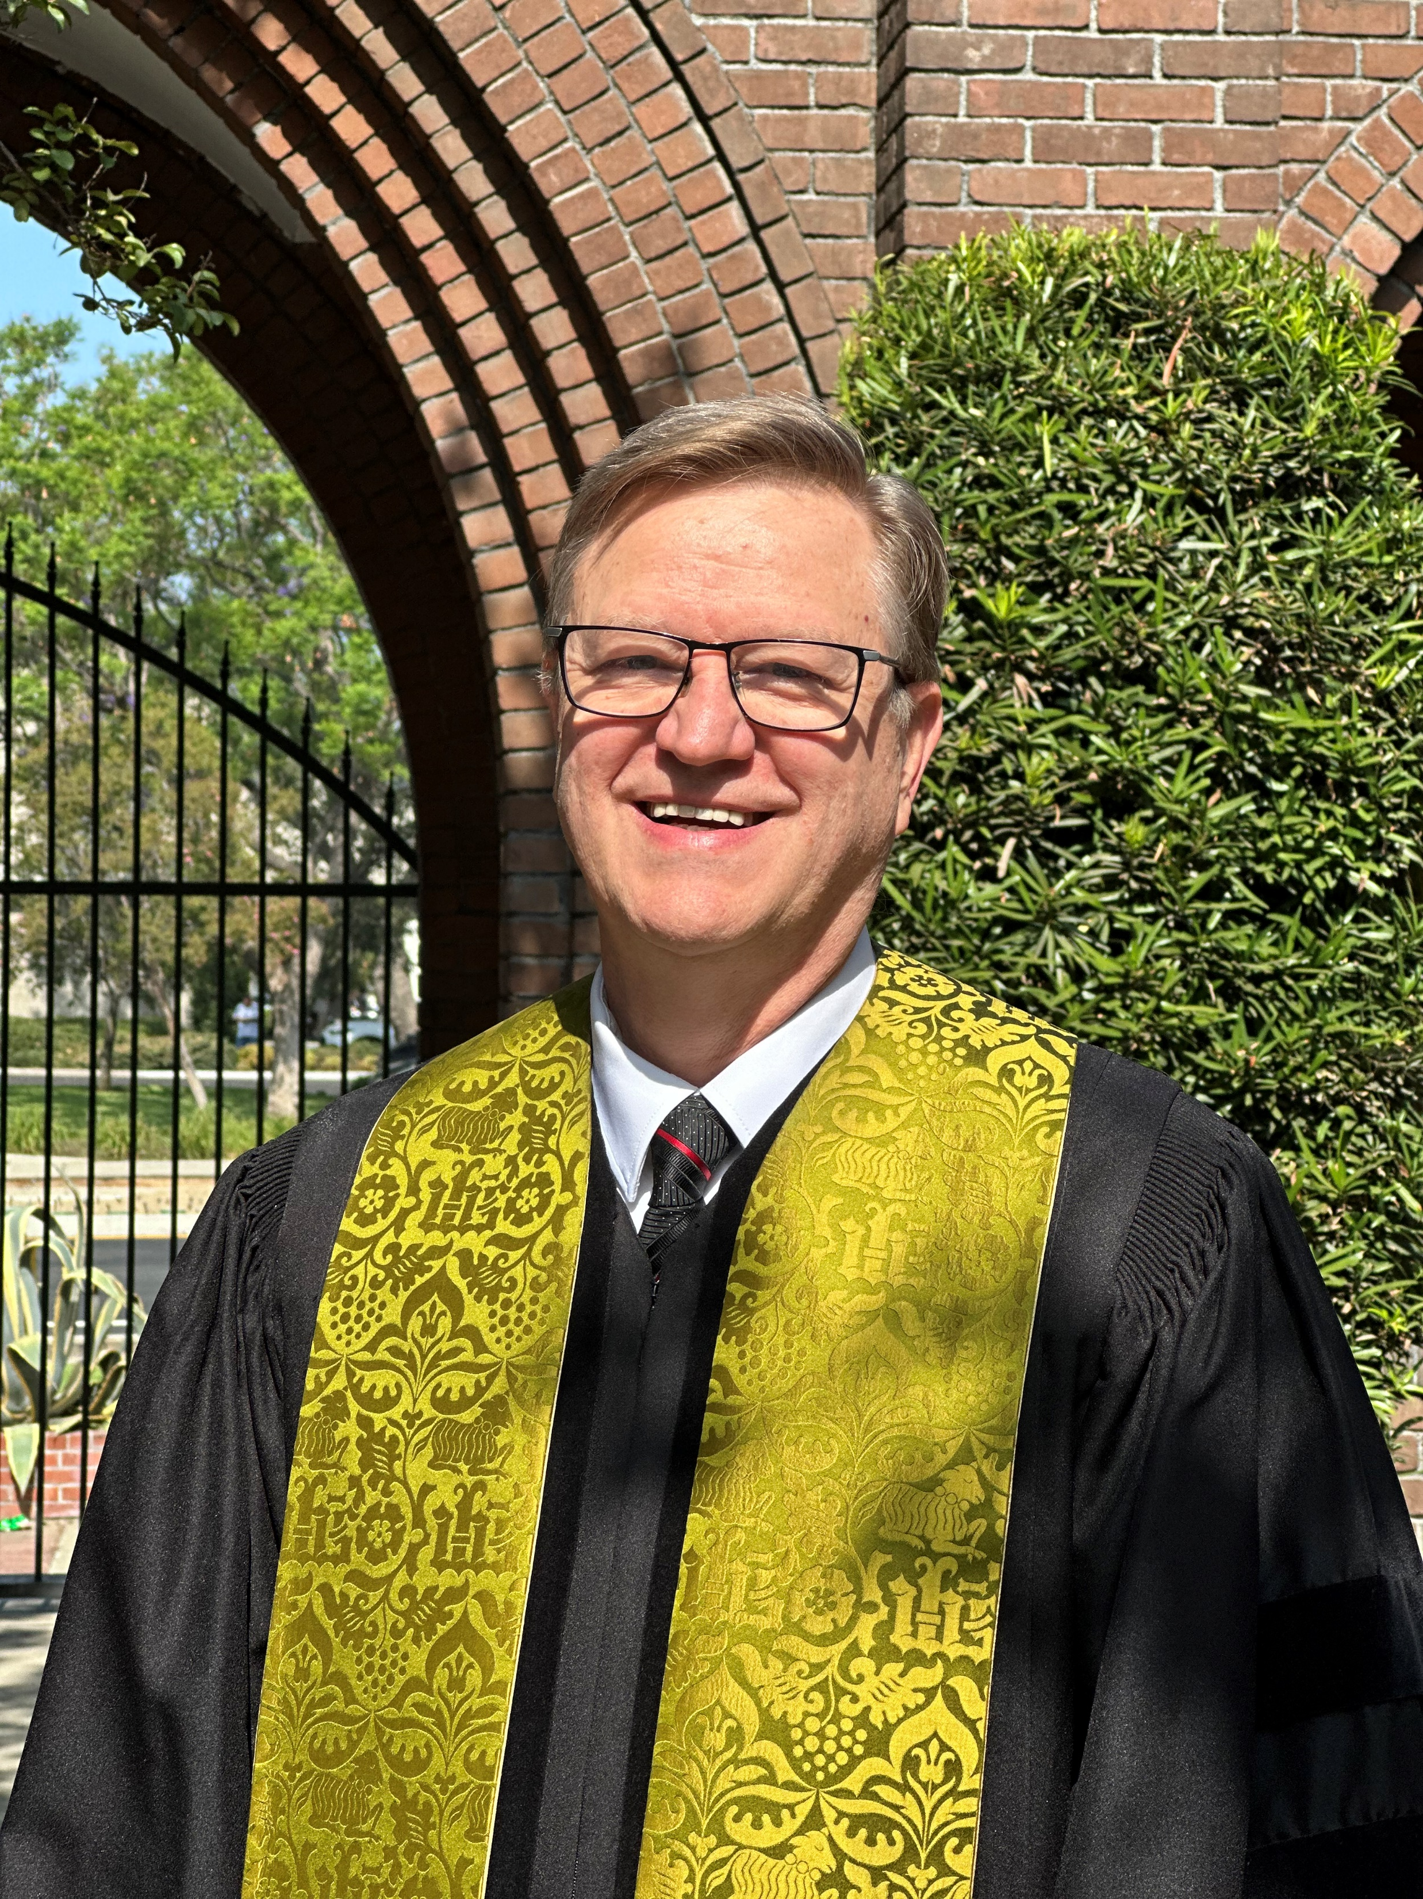
Senior Minister’s Message
Prophets to the Nations
“I appointed you a prophet to the nations.” Jeremiah 1:5
By: Rev. Dr. Patrick Horn
Jeremiah is told by God that he is appointed by God to be a prophet to the nations, not just Israel and Judah. The words that the Lord will put into the mouth of Jeremiah are for the whole world, for every nation. Does God still appoint prophets to the nations? I believe that he does. I believe that he has. I believe that we, the members of Pilgrim Congregational Church, are his prophets to the nations.
When we think of prophets we think of old men wearing robes, loudly crying out that the end is near or that terrible things are about to happen to those who do not repent. These can be helpful images, but they can also mislead. They can make us think that only men or older people can be prophets and that you are required to be weird to be a prophet. We know from scripture that these assumptions are not true: there is Deborah in the book of Judges and the three daughters of Philip in Acts 21, who are said to have the gift of prophecy.
A prophet is simply someone who speaks God’s Word. And that, I believe, ought to include all the followers of Christ. Paul encouraged all Christians to pursue prophecy. It is not as hard as it may sound. You have already done it, if you have said of some social, cultural, or governmental practice that harms the righteous or poor or needy, “That’s not right.”
We are all called to participate in prophecy of this sort. It does not need to be weird. It does not require you to be old. It only requires that you speak against practices that trample those in need.
We are called to be prophets to the nations. Our God is a God of Justice and Righteousness. Let us humbly speak the word of Truth against those practices of culture and policy and war which prevent people from having peaceful shelter and access to food and health services.
Isaiah 60:1 “Rise Up
2

Slide 3
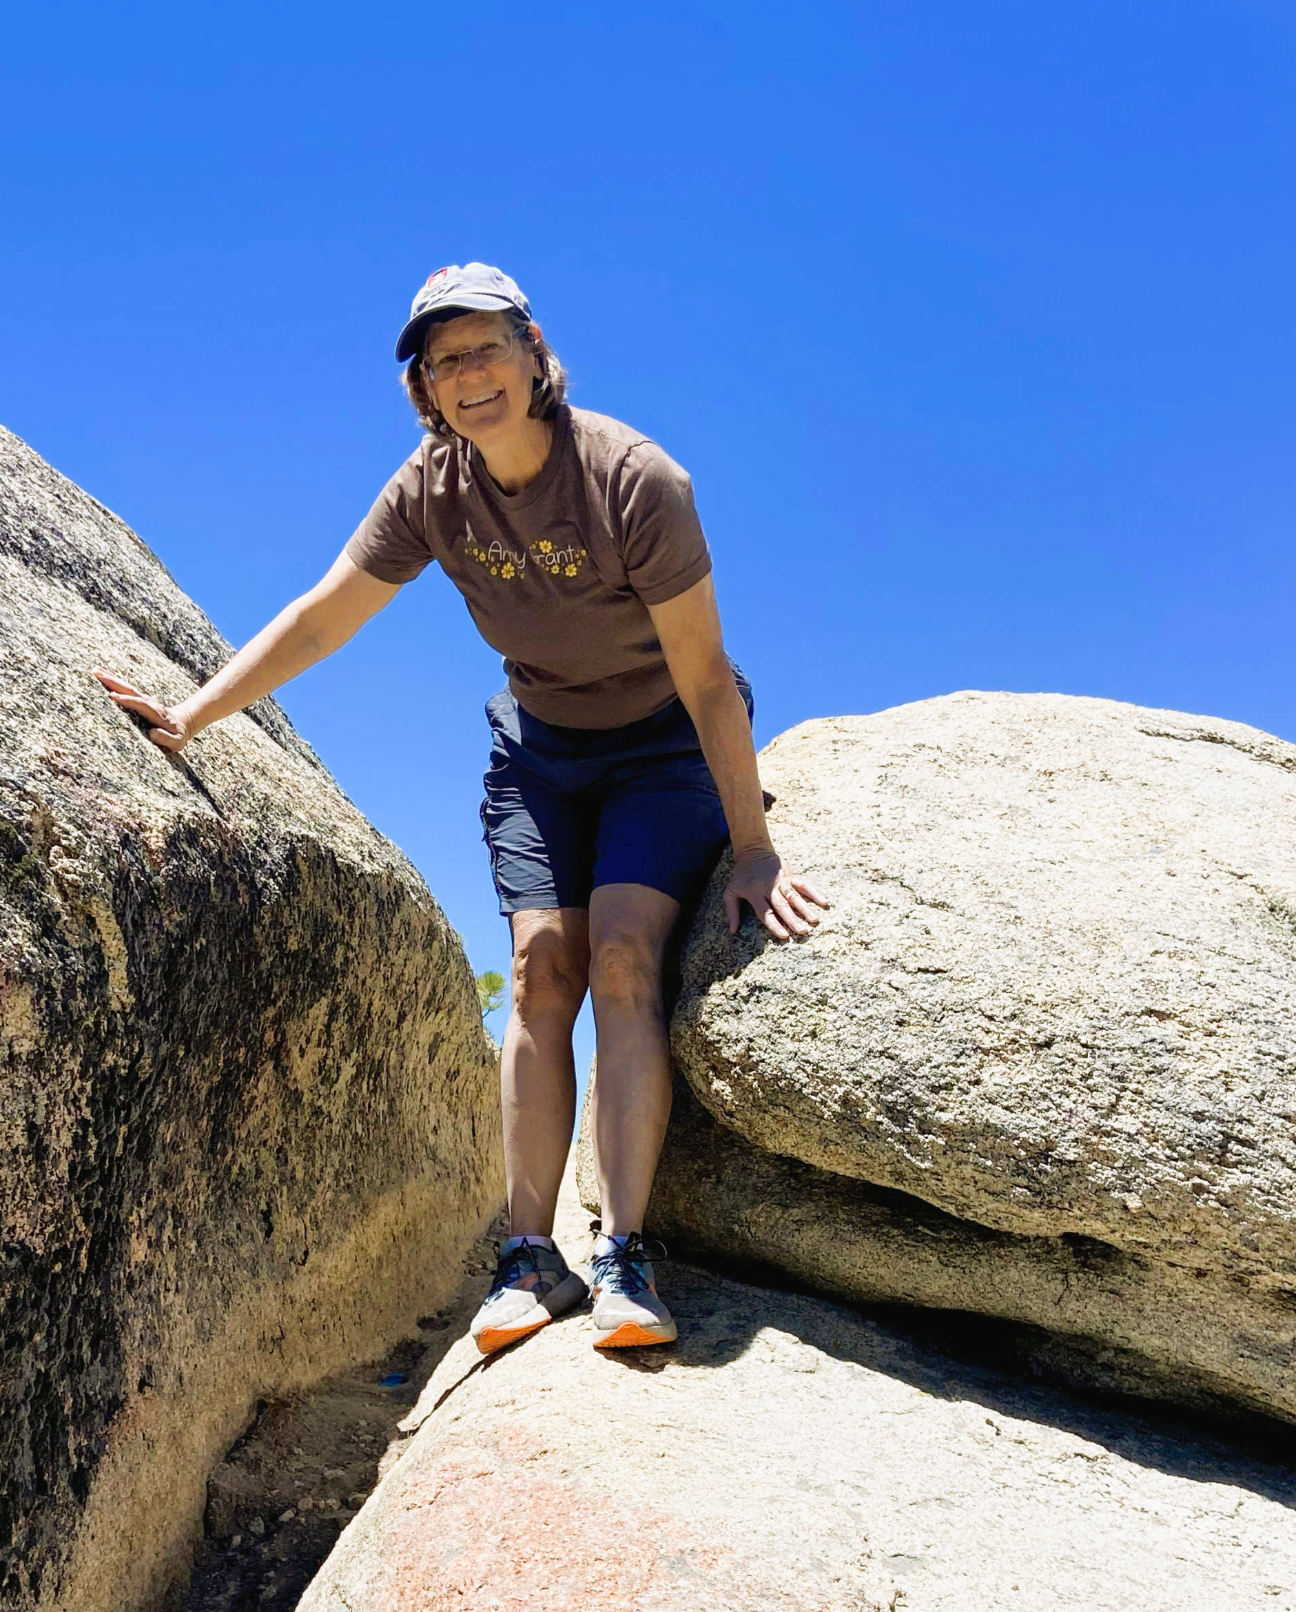
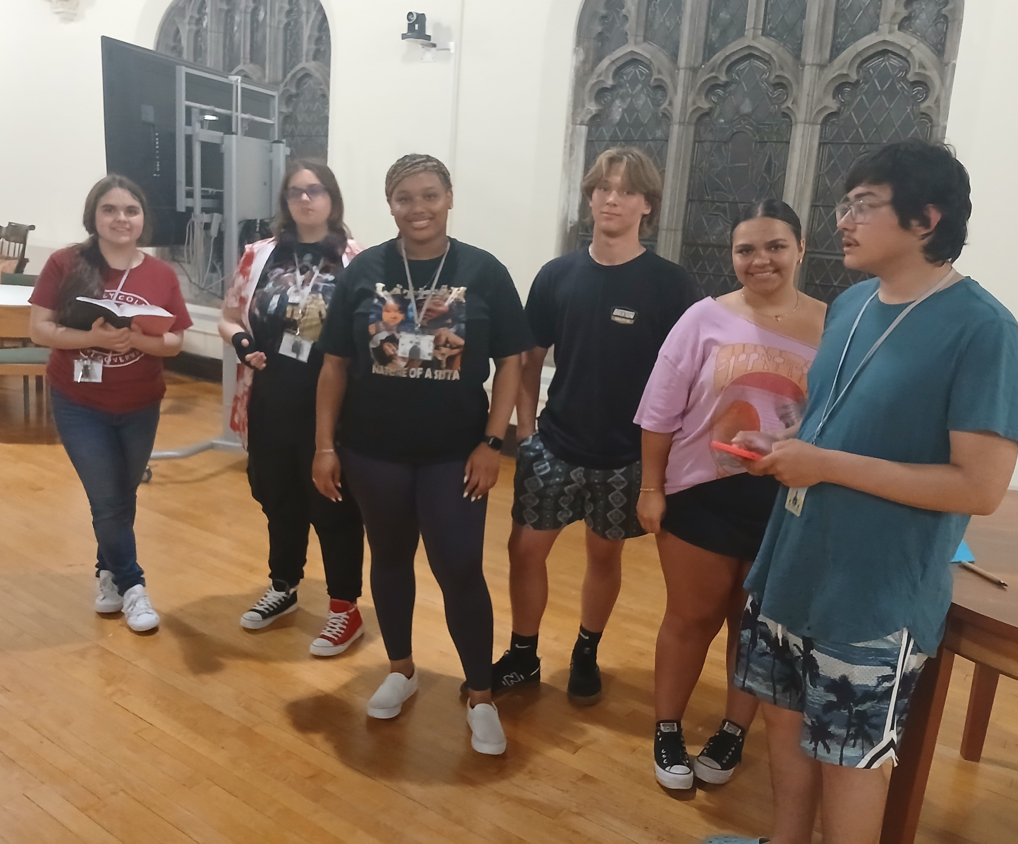
Associate Minister’s Message
This past month Tim Stillions and myself accompanied 7 of our young people, ages 15 – 20, to the National Association Conference for Youth and Young Adults. The conference featured…
Biblical Teaching: Our speaker spoke on how when we give our lives to the service of God, our ability to make a difference in the world becomes limitless.
Service: We worked with the adults to make 15,000 food packages, we sang in the adult worship, we cleaned the entire building for a Salvation Army, and we weeded and prepped the Garden of Eden (at Eden Seminary) for new plantings.
Community: We have small group discussions after the speaker, games to bring the group together, fun outings, and we partake of all meals together.
Leadership Training: Young people are chosen to help plan the conference the following year. Berlyne will be the youth Hope representative and Kodie Gray was chosen as one of the two NAPF representatives. Furthermore, there are plenty of opportunities during the conference for young people to lead. Our group, for instance, led an evening vespers.
What you see above is a great outline of the work I see us doing here at Pilgrim— seeking to equip and train up Christian Leaders who are dedicated both to the valuable traditions of the Congregational Way and meeting people where they are with Christ’s love.
Thank you for supporting the work as a congregation.
In God’s Love,
Rev. Heather Miner
Isaiah 60:1 “Rise Up
3

Slide 4
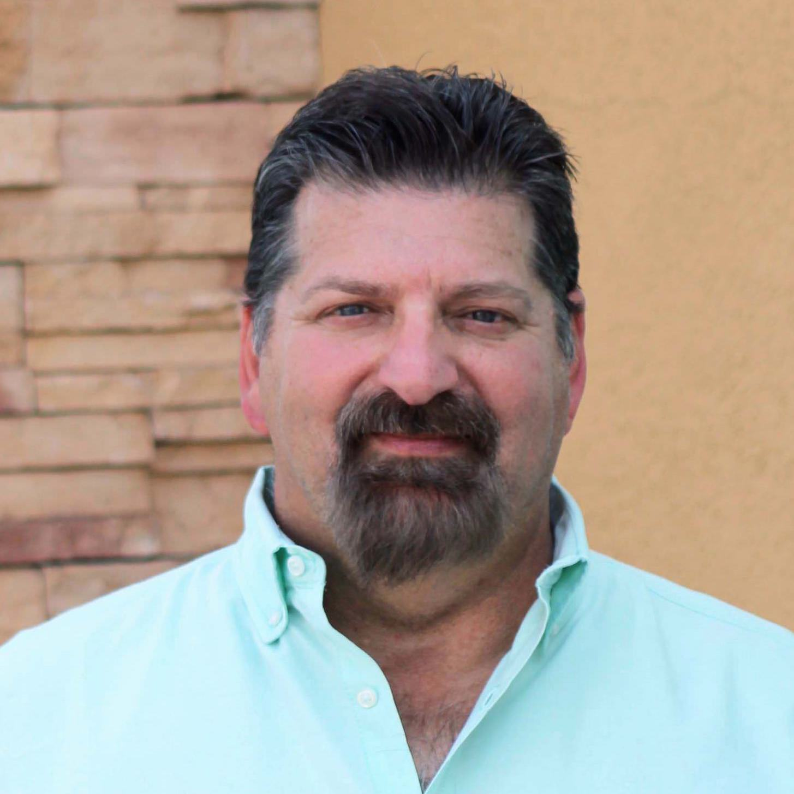
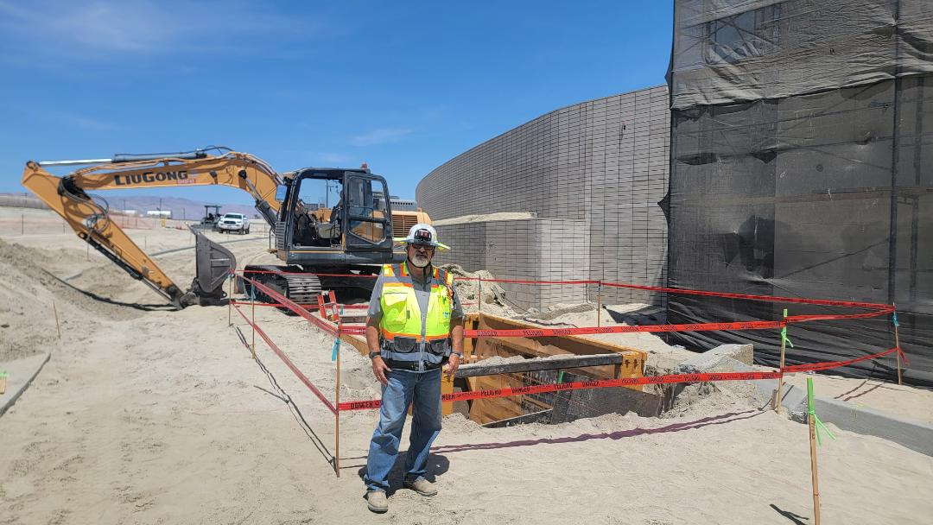
Moderator’s Message
RISE UP & Join the Team!
“Arise, shine; for your light has come,
and the glory of the Lord has risen upon you.”
~Isaiah 60:1~
My profession is in construction management, mostly overseeing very large commercial undertakings. Over the course of my career, I have managed, and been directly involved, in the construction of hotels, casinos, massive skyscrapers, stadiums, planned developments, and other large-scale projects in California, Nevada, Arizona, and on the east coast. I don’t swing a hammer anymore like in my younger days, but many times I am in the field working directly with the trades who make up the team. On large scale projects, on any given day there may be hundreds of trades all on a jobsite. In fact, there is a wide array of trades encompassing skilled professionals like carpenters, electricians, painters, plumbers, welders, rooters, masons, iron workers and heavy equipment operators, just to name a few. These trades all work under the management to complete jobs which create a final product. When I worked at the F1 Project in Las Vegas, there were more than 1800 workers onsite daily. That is a lot of people, doing a lot of different things in the same spaces.
Even though all the trades are absolutely crucial to getting the job done, many times they get in the way of each other; they argue and bicker, or worse. They have territorial issues and time management problems which have sometimes caused things to come to a halt. It’s something that can’t be helped mostly because of human nature. We are all working with a singular mindset occasionally forgetting the end goal. We are all forgetting that it requires our entire team effort to bring success. But the bottom line is, we need ALL the EXPERTS to get the job done, and without one specialty trade on site, the project would absolutely fail. Ultimately, we are all reminded we must be a team.
Sometimes it’s like that at church, or at least for me it is. Everyone has important work to do and occasionally we get in the way of each other. Maybe we even butt heads or strongly disagree. We have conflicts and territorial battles or simply don’t understand the value of another’s work. But every facet of our church “construction” is important and there’s no way we can achieve our goals if we aren’t working together.
When we are hot, tired, busy, pushed to our limits, frustrated and overwhelmed, let’s rise up and remember that we have a purpose and to fulfill God’s work, we need to remain a united team. Every staff member, committee, board, and volunteer group at Pilgrim Church is extremely important to our success.
From time to time when things become chaotic and unmanageable on our large jobsites, we take a time out for a “safety standdown” to reevaluate and regroup. Well, in our case, I won’t ask you to stand down, and instead we will RISE UP to embrace our challenges and to support our fellow Pilgrims. When conflict arises, take a minute to assess the big picture. Remember we are all in this together. We will go far with the support of one another, a cooperative mindset and a common goal. Thank you, Pilgrims, for your continued efforts, dedication and loyalty. Let’s RISE UP and remain a united team.
Ron Vanyo
2025-2026 Moderator
Isaiah 60:1 “Rise Up August 2025 4

Slide 5
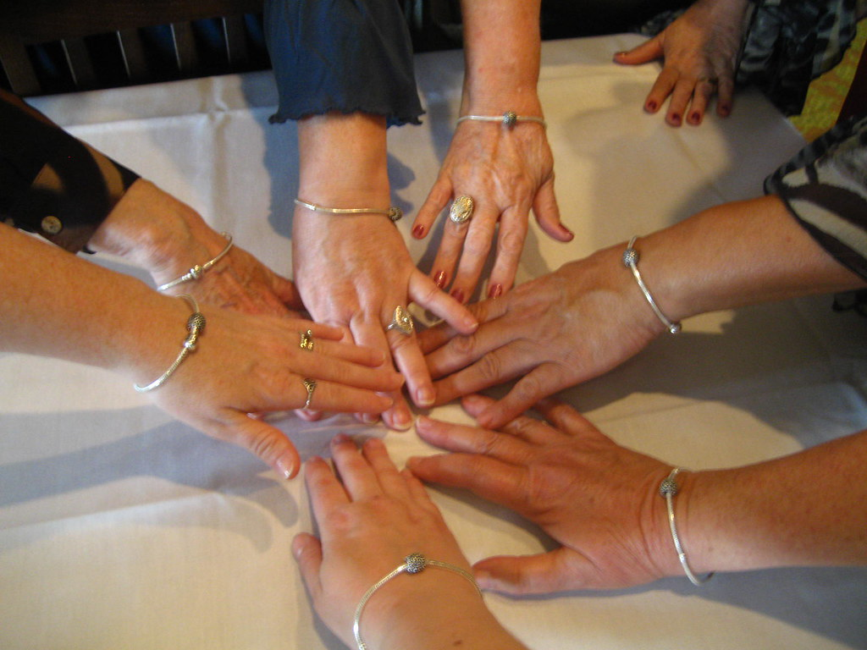
Trustees Message
“All Hands-On Deck!”
November Auction + Ways to Learn More
With a spirit of gratitude and collaboration, the Trustees share two important ways you can engage with our Pilgrim community this year.
Mark Your Calendars — Annual Auction, Saturday, November 15th
Our beloved Annual Auction returns this fall! This cherished tradition continues to be a highlight of our church life and a key fundraiser that brings our community together.
Beth Brooks had served faithfully in recent years, giving tirelessly of her time and energy to make the Auction a success. We are grateful for her leadership and example as we carry the event forward this year with the same spirit of excellence and care.
The Trustees, with assistance from Pilgrim Auxiliary and many helping hands, will be spearheading this year’s effort. We will need an "all hands-on deck" approach — and we know we can count on the generous spirit of our members and friends!
Now is the perfect time to start thinking about:
* Friends and family you can invite to the Auction
* Unique items, talents, or experiences you might contribute
We thank you in advance for your enthusiasm and generosity. Stay tuned for more details in the coming weeks and months!
Learning Together — Property & Finance Educational Opportunities
We want to make it easy for anyone to learn more about how our church works — from caring for our buildings to understanding our finances and annual budget.
If you’d like a personal, hands-on introduction to any of these areas, Steve and Jenni Whyte are happy to meet with you. It’s a great way to ask questions and learn at your own pace. Just contact Steve Whyte at whyte@whyteaccounting.com or (909)396-9357 to set up a time.
We may also offer group workshops later in the year, if there is interest. The more we learn together, the better equipped we are to support and sustain the life of our church.
In stewardship and community,
Jenni Whyte, The Board of Trustees
Isaiah 60:1 “Rise Up 5

Slide 6


From the Librarian
AUGUST LIBRARY NEWS
Is the heat getting you down? Check out a new book and escape with your imagination!
  Great Big Beautiful Life by Emily Henry (Reese’s Book Club)
  The Phoenix Pencil Company by Allison King
  You Are Fatally Invited by Ande Pliego
  Hidden Nature by Nora Roberts
If you are a fan of old movies you will enjoy Dark City Dames; the Women Who Defined Film Noir by Eddie Muller. It has color copies of old movie posters, wonderful publicity photos, interesting biographies and behind the scenes stories.
Stop by the library and check us out!
Megan
Isaiah 60:1 “Rise Up
6

Slide 7



Christian Education
The Pews News
Returns 8/17/25
The Pews News returns from Vacation for publication on Sunday, August 17, 2025. Be SURE to send in all your updates, news, summer vacation stories, highlights, birthdays and anything you want to share with the community! Does your Board or Committee have an announcement or event? Then we want to know! This is your news and we LOVE to hear from you! Submissions should be made by noon on Thursdays by email to Christine or Sue.
christine.swartz@yahoo.com
momselters@aol.com
Volunteer to Assist
In Summer Sunday
School
Our Summer schedule continues through Rally Sunday on September 14, 2025. Please sign up to assist with coverage for the summer so the teachers can enjoy a well-deserved rest. There are opportunities for nursery care, elementary, junior high and high school classes. Please contact Sunday School Superintendent Jan Manildi at 909-262-6126 or CE Chair Christine Vanyo at 909-919-4621. Pilgrim kids appreciate your support!!!
High School
Speaker Sunday
Sign Up to Speak to the High School Students
We are looking for volunteers to sign up and speak to the High School Students every 4th Sunday. You can share about a particular topic, spiritual event in your life, or use one of our suggested discussions. This is a great opportunity to share your knowledge and experience with our High School kids and help foster the intergenerational relationships that are so important here at Pilgrim! Contact Superintendent Jan at 909-262-6126 or CE Chair Christine at 909-919-4621.
Isaiah 60:1 “Rise Up
7

Slide 8



Christian Education
Back to School
Pool Party
Mark your Calendar and Make a splash at our end of summer back to school Pool Party. Join us on Sunday, August 17, 2025 at 1:00 p.m. at the Vanyo Home, 6321 Topaz Street, Alta Loma, CA. We’ll have swimming, lunch, dessert and a devotional by Pastor Heather. Please RSVP so we have enough food and drinks. Call or text Christine at 909-919-4621. Open to all ages and kids under age 6 need a parent or guardian to come.
Save the Date
For Backpack
Blessings
Bring your briefcase, backpack, knapsack or duffle bag for the Blessing of the Backpacks on Sunday, August 24, 2025 during worship service. The Board of Christian Education will provide Blessing Tags to clip on your pack as a reminder of God’s blessings on your life. We will have a special devotion for kids and youth returning to school and college. Mark your calendar for this. special event.
Sunday
August 24th
Join us for a fun time of fellowship on Sunday, August 24, 2025
following Worship Service. Bring your favorite dish to share and enjoy an afternoon of food and friends. Drinks and set up will be provided. Hosted by the Membership Board, Christian Ed Board and Pilgrim Auxiliary. For questions, call Bonnie Seath or Christine Vanyo.
Isaiah 60:1 “Rise Up
8

Slide 9


Christian Education
SCHOOL SUPPLY DRIVE
For Inland Valley Hope Partners
Collection Period Sunday
July 15th—Sept. 1st
SUPPLIES NEEDED
PENS, PENCILS,
MARKERS, CRAYONS, PENCIL SHARPENERS, ERASERS, RULERS,
PENCIL CASES,
GLUE STICKS,
SPIRAL NOTEBOOKS, CALCULATORS, HIGHLIGHTERS,
INDEX CARDS
Collection Period Sunday
July 15th—Sept. 1st
Also accepting checks made out to Pilgrim Congregational Church (Memo: School Supply Drive) Check/Cash donations due: 8/25
Isaiah 60:1 “Rise Up

Slide 10

Christian Education
Celebrate Our Grandparents & Grand People on Sep. 7th
Calling All Grandparents, Mee-Maws, Papas, Mimis, Nanas, Grannies, Grampies, Pops, Gigis, Nonnas & Nonnos, (and Fafas) and all the Grand Adults blessed with grandchildren and special young people! Join us for a celebration and recognition on Sunday, September 7, 2025. We will honor our grandparents during the Worship Service with a special event. Following worship, the celebration will continue with refreshments, crafts and photo opportunities. Be sure to attend this wonderful time of generational celebrations!
Everyone is
Invited on
Sept. 14!
Are you ready for AMAZING fellowship, exhilarating experiences and hands-on learning about God’s love? Then “join the excitement on Sunday, September 14, 2025 for Rally Sunday” as we begin our Sunday School Church year. We have a new Roster of teachers and volunteers and lots of fun activities and events.
The fun begins at 9:00 a.m. with donuts and fellowship. Be sure to come early to meet your Teachers, fill out the registration paperwork and provide your contact information. Starbucks Sundays begin now! When you bring a guest to Sunday School during the month of September, you and your guest will receive a Starbucks gift card!!
9:00 to 9:30 a.m. Student Registration
Volunteer Sign Ups & Information
High School Nursery Assistants
10:00 a.m. Worship Service
11:15 a.m. Burger Bash Lunch (Suggested donation $5 per person)
Teacher & Volunteer Introduction
RSVP by September 1st to office at 909-622-1373 or email
pilgrimoffice@pilgrimchurchpomona.com
Isaiah 60:1 “Rise Up
August 2025
10

Slide 11
Christian Education
The CE Connection
Hello Pilgrim Family, Friends and Youth! The Pilgrim Youth and Board of Christian Education are excited to announce our upcoming events!
Date | Event | Location
Aug. 16, 2025 | Sunday School Teacher Worship | CE Office & Classrooms
Aug. 17, 2025 | Back to School All Youth Swim Party | Vanyo Home
Aug. 24, 2025 | BLESSING OF THE BACKPACKS | Pilgrim Church, Sanctuary
Aug. 24, 2025 | Church Wide Potluck Lunch Youth Service Work | Kitchen, Gym, Pilgrim Hall
Sep. 7, 2025 (Sun) | Grandparent’s Day Celebration | Pilgrim Church & Gym
Sep. 13, 2025 (Sat) | Rally Sunday Set Up | Pilgrim Church, Gym, Kitchen
Sep. 14, 2025 (Sun) | Rally Sunday & Burger Bash | Kitchen, Gym and Pilgrim Hall
Sep. 21, 2025 (Sun) | Talent Show hosted by Membership Bd. | Pilgrim Church
Oct. 11, 2025 (Sat) | Knott’s Berry Farm Youth Field Trip 10 a.m. to 6 p.m. (Depart campus @ 9 a.m.) | Off Campus
Oct. 18, 2025 (Sat) | Rummage Sale – Youth Assignments & Service Work | All Campus
Oct. 24, 2025 | Trunk or Treat Set Up | Pilgrim Church, Gym, Parking Lot
Oct. 25, 2025 | Trunk or Treat | Pilgrim Church, Gym, Parking Lot
Nov. 2, 2025 | Christmas Program Rehearsals Begin | Pilgrim Hall
Nov. 9, 2025 | Youth Veteran’s Day Recognition | Pilgrim Church
Nov. 15, 2025 | Church Auction – Youth Service Work | Pilgrim Church, Kitchen, Gym & Pilgrim Hall
Nov. 30, 2025 | Youth Christmas Lunch & Tree Decorating | Pilgrim Hall
For questions or information about these events, please contact Pastor Heather at 909-622-1373 or CE Chair Christine Vanyo at 909-919-4621 or connect with a CE Board Member. If you are interested in hosting, sponsoring or participating in our events, please let us know! We love the support of our Pilgrim Family!
Isaiah 60:1 “Rise Up
11

Slide 12


Our Nursery
Welcome to Our
Newest Nursery
Teacher!
Please be sure to welcome Brandis Pena who is our newest Nursery/Preschool Teacher. You will find Brandis and her son Hunter in our nursery where she will be teaching the preschoolers and caring for the infants. A new infant and preschool curriculum will begin this fall and we are so thankful for the dedication of our nursery volunteers. If you would like to become a regular nursery substitute, please contact Nursery Manager, Julie McCormick at 909-296-2306.
Rummage Sorting Update
Autumn Rummage Sale
Saturday,
October 18th
8am—1pm
Rummage Sorting
Join us on Wednesdays, 8:00am—10:30am when weather permits.
We enjoy good fellowship while serving Pilgrim Church sorting through donations for our Rummage Sales. Please call ahead to confirm there have not been any changes to the week’s schedule, M-F, 909-622-1373.
Isaiah 60:1 “Rise Up
12

Slide 13

Membership
Vegetarian
Isaiah 60:1 “Rise Up August 2025 13

Slide 14



Membership
Sunday, September 21st
Lunch following worship service.
Noon: SHOWTIME
Join us for lunch
following Worship Service.
After lunch we will enjoy an
afternoon of music, theater and more.
Sign up today & share your talent as a
singer, musician, actor, poet, & more or
just come to enjoy the show.
If you are joining us on stage or just coming for the show,
Don’t miss out on this day of fun & fellowship.
’
We are requesting donations for the lunch.
Otherwise, the show is FREE.
Please submit your act to Bill Parnell
Please RSVP for the lunch by Wed. Sept. 17th to
PilgrimOffice@pilgrimchurchpomona.com
or call the office m-f, 9:00 am to 5:00 pm
909-622-1373
Isaiah 60:1 “Rise Up
14

Slide 15

Harmonia
Isaiah 60:1 “Rise Up August 2025 15

Slide 16

Our Community
Isaiah 60:1 “Rise Up
16

Slide 17


Our Community
Isaiah 60:1 “Rise Up
August 2025 17

Slide 18

Isaiah 60:1 “Rise Up August 2025 18

Slide 19


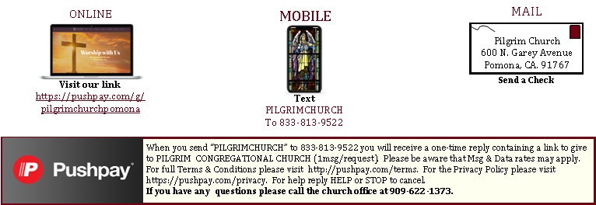
Church Ministries
Band of Prayer
If you or someone you know is in need of prayers, please send your Band of Prayer requests to Sue Shedd via email at saintshedd@roadrunner.com or leave a message at 909-622-1373.
Card Corner
Every 3rd Sunday during Fellowship Hour the Card Corner will be available with cards and addresses for Pilgrim members to share a friendly note with our families out of state, homebound or we just haven’t seen in awhile. Stop by and write a card to let our Pilgrims know we are thinking about them.
Ways To Give
When you text “PILGRIMCHURCH” to 833-813-9522 you will receive a one-time reply congaing a link to give to PILGRIM CONGREGATIONAL CHURCH (1msg/request). Please be aware that MSG & Data rates may apply. For full Terms & Conditions please visit http://pushpay.com/terms. For the Privacy Policy please visit https://pushpay.com/privacy. For help reply HELP or STOP to cancel. If you have any questions, please call the church office at 909-622-1373.
Isaiah 60:1 “Rise Up August 2025 19

Slide 20
Service Notes
August 3rd ^{Eighth Sunday after Pentecost} Presiding Minister: Rev. Heather Miner Worship Assistant: Rev. Keith Eades ^{Lesson 1: Hosea 11:1-11} ^{Lesson 2: Luke 12:13-31} ^{Color: Green} Theme: Seek First the Kingdom of God ^{Sermon: My Soul’s Quest} Ushers: Sylvia Osborn, Guadalupe Oceguera, Jenni Whyte and ^{Lorraine Rogers} Acolytes: Samantha Campbell & Armondo Piercy Fellowship Host: Members At Large This morning’s flowers are thoughtfully and lovingly provided by ^{Janet Beech: “I love Pilgrim,} ^{Pilgrim loves me...} ^{And so we make} ^{A perfect family!”} August 10th ^{Ninth Sunday after Pentecost} Presiding Minister: Rev. Dr. Patrick Horn Worship Assistant: Ms. Sherry Glab ^{Lesson 1: Luke 12:32-40} ^{Lesson 2: Isaiah 1:1,10-20} ^{Color: Green} Theme: There’s no practice of faith without morality ^{Sermon: “Learn to Do Good”} Ushers: Ben Selters, Sue Selters and Janet McBride ^{Acolytes: Kodie Gray} ^{Fellowship Host: Outreach} This morning’s flowers are thoughtfully and lovingly provided by Sherry Glab: “In memory of Tom Glab. ^{Happy Birthday.”} August 17th ^{Tenth Sunday after Pentecost} ^{(Communion Sunday)} Presiding Minister: Rev. Dr. Patrick Horn Worship Assistant: Mr. Andrew Olson ^{Lesson 1: Luke 12:49-56} ^{Lesson 2: Isaiah 5:1-7} ^{Color: White} Theme: God pays attention to the sufferer ^{Sermon: “God Hears the Cry”} Ushers: Ron Vanyo, Dulce Ruiz & Bob Wheeler Acolytes: Preston Dague & Charlie McCormick Fellowship Host: Friendship Guild This morning’s flowers are thoughtfully provided: “In loving memory of Dr. H. R. Mengle, by his family.” Isaiah 60:1 “Rise Up Isaiah 60:1 “Rise Up | August 24th Eleventh Sunday after Pentecost (Blessings of the Backpacks/All Church Potluck) Presiding Minister: Rev. Dr. Patrick Horn Worship Assistant: Mr. Ron Vanyo ^{Lesson 1: Luke 13:10-17} ^{Lesson 2: Jeremiah 1:4-10} ^{Color: Green} Theme: We are prophets to the nations Sermon: Over Nations and Over Kingdoms Ushers: Susan Shedd, Sharon Willison, Lisa Keepers and Michael Lawing Acolytes: Isabella & Jasmine Marceleno ^{Fellowship Host: Music Board} This morning’s flowers are lovingly provided by Bonnie Seath: “In joyful celebration of Cousin Ruth’s 84th birthday; Sister Betsy and Brother-in-Law Jim’s 42nd Wedding Anniversary; Nephew Ryan and Kathryn’s 4th Wedding Anniversary. We have many blessings to be thankful for.” August 31st ^{Twelfth Sunday after Pentecost} Presiding Minister: Rev. Dr. Patrick Horn Worship Assistant: Mr. Kodie Gray ^{Lesson 1: Hebrews 13:1-8,15-16} ^{Lesson 2: Jeremiah 2:4-13} ^{Color: Green} Theme: Forsaking God’s Fountain for our own ^{Sermon: Changing Gods} Ushers: Sylvia Osborn, Guadalup Oceguera, Jenni Whyte and ^{Lorraine Rogers} Acolytes: Samantha Campbell and Armondo Piercy ^{Fellowship Host: Membership} This morning’s flowers are thoughtfully and lovingly provided by Jan Manildi: “In joyful celebration of our daughter Joey’s birthday, and our granddaughter Jaye’s birthday.” Boutonnieres for August are thoughtfully provided, “With Blessings for the opportunity to worship at Pilgrim Congregational Church each and every Sunday.” Liturgical Notes by Rev. Dr. Patrick Horn: Green symbolizes growth and life, hope and anticipation. Green is used in Ordinary time, the period of the Church calendar which gives attention to the Lord’s life and ministry; it reminds us that the mission of the Church is to love the world and share the hope of Christ. White symbolizes purity, innocence, and birth. It is associated with the brightness of the heavens during daytime and was used to symbolize the purity of heaven and the angels. It also came to be associated with joy, celebration, and peace. White is the liturgical color of Christmas, Epiphany, and Easter.lizes
To Listen to the Sunday Service on your Phone: Dial +1-669-900-9128. Then when prompted, enter the Meeting ID: 330 195 900, followed by the pound (#) sign. Then enter Passcode 1887, followed #. To View Sunday Service Online: Visit Facebook Page or YouTube Channel at: Pilgrim Congregational Church Pomona.
Isaiah 60:1 “Rise Up
19

Slide 21

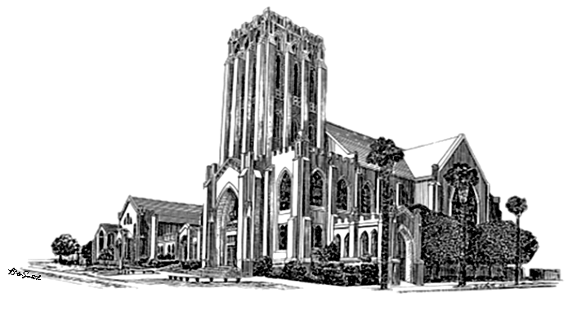
Calendar Notes: August 2025
Weekly / monthly Every Morning, Mon. - FRI. Daily Devotional 9am via Facebook Live and Zoom Every Sunday 9am – Gather & Greet 10am – Worship Service (In-person & Online) Sunday School for 1st – 12th grade (following the Lord’s Prayer) 11am - Fellowship Hour Every Tuesday Twilight Bible Study 5:45pm via Facebook Live & YouTube Every 1st Tuesday (October - June) Pilgrim Auxiliary Meeting, Program & Luncheon Every 1st Wednesday 7pm ~ Church Council Meeting Every Wednesday 8am to 10:30am ~ Rummage Sorting Every Thursday 10am ~ Joyful Endeavors Every Friday 8am ~ Men’s Breakfast at Roberta’s Inn, La Verne EVERY 3RD SUNDAY 11:30am ~ Board Meetings EVERY 5th SUNDAY Sunday Funday (Sunday School) | UPCOMING EVENTS August 6th 7:00pm Church Council Meeting August 16th 10:00am Teacher’s Meeting (C.E. Office) August 17th 10:00am Communion 11:30am Meeting Sunday August 24th Blessings of the Backpacks 11:00am All Church Potluck 11:30am Board of Trustees Meeting
Isaiah 60:1 “Rise Up August 2025 21

Slide 22
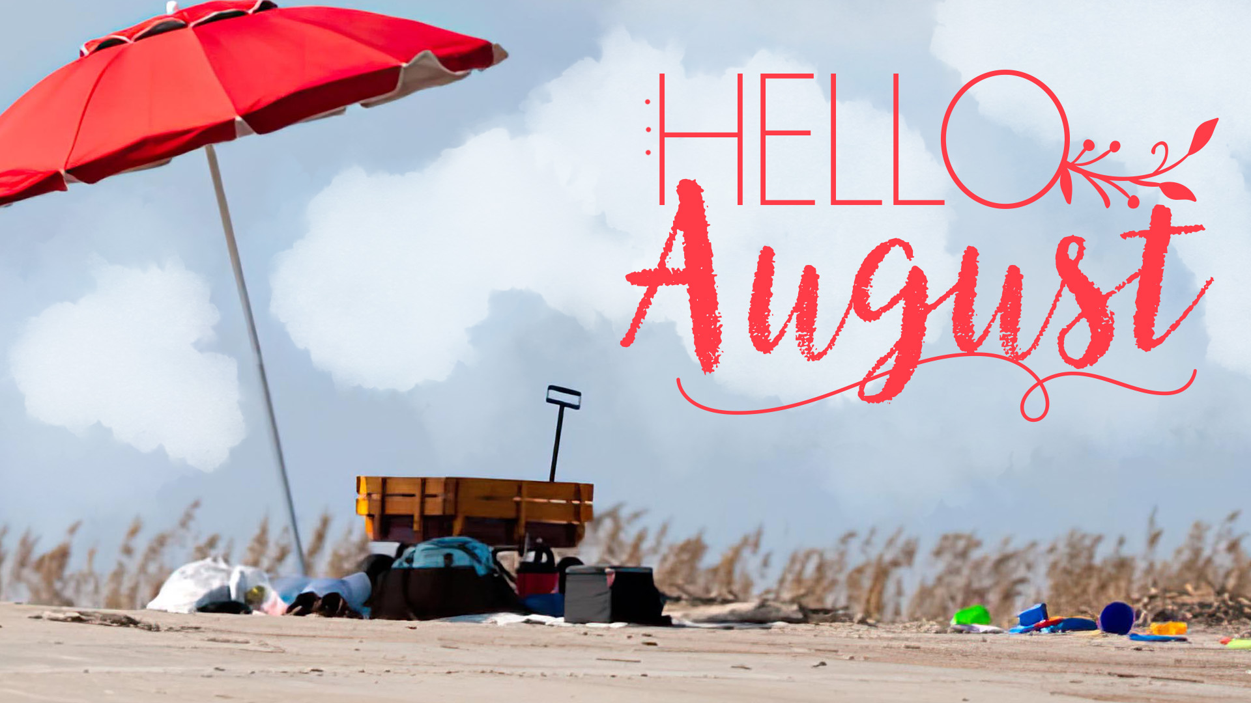



Sunday | Monday | Tuesday | Wednesday | Thursday | Friday | Saturday
 |  |  |  |  | 1 9am Morning Devotional 8am Men's Breakfast | 2 NOON NA Group Meeting
3 9am Gather & Greet 10am Worship Service 11am Fellowship Hour | 4 9am Morning Devotional 10am Alanon "Serenity“ 1:00pm Staff Meeting | 5 9am Morning Devotional 9:30am CEA/HOW 3:30pm Pomona Moose 5:15pm Cheerleaders 5:45pm Twilight Bible Study | 6 9am Morning Devotional 8am Rummage Sorting 6pm Basketball 7:30pm NA Support | 7 9am Morning Devotional 10am Joyful Endeavors 7:30pm AA Mother Group | 8 9am Morning Devotional 8am Men's Breakfast | 9 NOON NA Group Meeting
10 9am Gather & Greet 10am Worship Service 11am Fellowship Hour | 11 9am Morning Devotional 10am Alanon "Serenity 1:00pm Staff Meeting | 12 9am Morning Devotional 9:30am CEA/HOW 3:30pm Pomona Moose 5:15pm Cheerleaders 5:45pm Twilight Bible Study | 13 9am Morning Devotional 8am Rummage Sorting 6pm Basketball 7:30pm NA Support | 14 9am Morning Devotional 10am Joyful Endeavors 7:30pm AA Mother Group | 15 9am Morning Devotional 8am Men's Breakfast | 16 10am Teacher’s Meeting (C.E. Office) NOON NA Group Meeting
17 9am Gather & Greet 10am Worship Service 10:00am Communion 11am Fellowship Hour 11:30am 11:30am Choir Rehearsal 11:30am Membership Board Meeting | 18 9am Morning Devotional 10am Alanon "Serenity 1:00pm Staff Meeting | 19 9am Morning Devotional 9:30am CEA/HOW 3:30pm Pomona Moose 5:15pm Cheerleaders 5:45pm Twilight Bible Study | 20 9am Morning Devotional 9am Rummage Sorting No Library Committee 6pm Basketball 7:30pm NA Support | 21 9am Morning Devotional 10am Joyful Endeavors NOON Lions Club Lunch & Mtg 7:30pm AA Mother Group | 22 9am Morning Devotional 8am Men's Breakfast | 23 NOON NA Group Meeting
24/31 Blessings of the Backpacks 9am Gather & Greet 10am Worship Service 11:00am Fellowship Hour 11:30am Board of Trustees 11:00am All Church Potluck | 25 9am Morning Devotional 10am Alanon "Serenity 1:00pm Staff Meeting | 26 9am Morning Devotional 9:30am CEA/HOW 3:30pm Pomona Moose 5:15pm Cheerleaders 5:45pm Twilight Bible Study | 27 9am Morning Devotional 9am Rummage Sorting 6pm Basketball 7:30pm NA Support | 28 9am Morning Devotional 10am Joyful Endeavors 7:30pm AA Mother Group | 29 9am Morning Devotional 8am Men's Breakfast | 30 NOON NA Group Meeting
22
Isaiah 60:1 “Rise Up August 2025 22

